Slide 1
NORMAN ROCKWELL’S FOUR FREEDOMS: VISUALIZING THE RULEOF LAW
This project is financially assisted by a generous grant from the Virginia Law Foundation. The Virginia Law Foundation promotes through philanthropy the rule of law, access to justice and law-related education.

Slide 2
THE RULE OF LAW
"The rule of law is the most important political ideal today, yet there is much confusion about what it means and how it works."
Brian Tamanaha
DEFINITION:
Civil society based on the core beliefs of:
Consent of the Governed
Limited Government
Obedience to the Law
Thereby guaranteeing to its citizens:
Fairness Stability
Equality Certainty
Justice Security
Trust Peace
Notes:
It is the rule of law that is the foundation for representative republican democracy, constitutional government, a stable economic system, and the ideals and institutions associated with civil society.

Slide 3
"Great nations write their autobiographies in three manuscripts – the book of their deeds, the book of their words and the book of their art." – John Ruskin
Notes:
Note: Here is an opportunity to remind students that history is more than words on a page. Our nation’s history – its ideals, accomplishments, and failures – surrounds us in the art, architecture, sculpture, films, cartoons, music, popular culture, and current events that we experience daily. This PPT on Norman Rockwell will, hopefully, help them appreciate this idea and encourage them to look for other examples of how history is learned outside the classroom as well as in the textbooks they study in the classroom.

Slide 4
“In the future days, which we seek to make secure, we look forward to a world founded upon four essential human freedoms.
The first is freedom of speech and expression--everywhere in the world.
The second is freedom of every person to worship God in his own way--everywhere in the world.
The third is freedom from want--which, translated into universal terms, means economic understandings which will secure to every nation a healthy peacetime life for its inhabitants-everywhere in the world.
The fourth is freedom from fear--which, translated into world terms, means a world-wide reduction of armaments to such a point and in such a thorough fashion that no nation will be in a position to commit an act of physical aggression against any neighbor--anywhere in the world.”
- Franklin D. Roosevelt, 1941
Notes:
Part of State of the Union Address for 1941
Begins the speech by addressing the global struggle against “the new order of tyranny” – the antithesis of the ROL – “…a new one-way law, which lacks mutuality in its observance, and…becomes an instrument of oppression.”
Throughout the speech he stresses
1. “respect for the rights and dignity” of all men
2. “principles of morality”
3. the protection of “essential human rights” – “simple, basic things”
End of speech he offers his description of democracy: “…there is nothing mysterious about the foundation of a healthy and strong democracy”:
1. “Equality of opportunity for youth and others.”
2. “Jobs for those who can work.”
3. “Security for those who need it.”
4. “The ending of special privilege for the few.”
5. “The preservation of civil liberties for all.
The end of speech proposed Roosevelt’s vision of a post-war world based on four basic human freedoms:
1. Freedom of speech and expression
2. Freedom of conscience
3. Freedom from want
4. Freedom from fear
He concludes the speech by reaffirming his and the country’s “faith in freedom”: “Freedom means the supremacy of human rights everywhere.”
Thus we begin with the words that inspired an artist to create the art that would inspire a nation to action.
More importantly, we read in the speech and see in the paintings the basic principles of the ROL that Norman Rockwell will visualize in different ways in future illustrations and paintings.

Slide 5
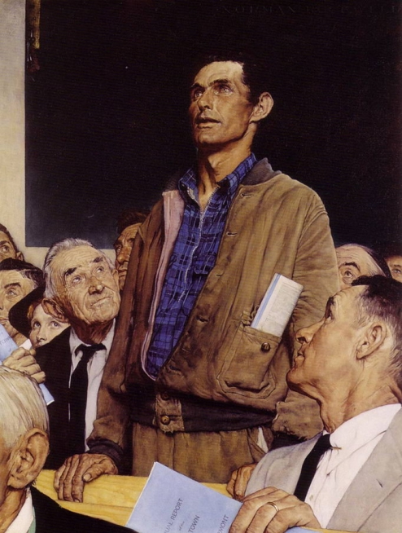
Freedom . . .
Freedom of Speech, Oil on Canvas, Norman Rockwell, 1943, Norman Rockwell Museum, Stockbridge, MA
Notes:
Office of Emergency Management and the Office of Government Reports commissioned works of art that would visually convey the Four Freedoms to the public (reminiscent of the WPA under the New Deal)
However, the effort was not successful as during the Summer of 1942 the Office of War Information reported that “only about 1/3 of the American public has any knowledge of the Four Freedoms as such, [and] no more than 2% were able to identify all four of them correctly”
Rockwell had been searching for an opportunity to paint a “big picture” – a work of art that was in no way an illustration and carried a universal meaning. He focused on the Four Freedoms
According to Rockwell, at 3:00 AM early one morning it hit Rockwell that he should use his neighbors - average, middle class/blue color Americans – to serve as models in a series of 4 posters visually reflecting the Four Freedoms
For speech, Rockwell was inspired by Jim Edgerton who had recently stood up at a town hall meeting and passionately took a position on the hot topic of the day – the construction of a new high school in Arlington. His position was in the distinct minority – he advanced an unpopular perspective, yet those present respectfully let him speak. No one interrupted him. No one threw out catcalls – they respectfully allowed him to speak his mind.
Local gas station owner Carl Hess served as Rockwell’s model

Slide 6
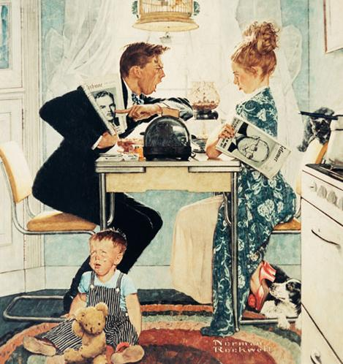
Dewey vs. Truman, Oil on Canvas, Norman Rockwell, October 30,1948, Norman Rockwell Museum, Stockbridge, MA
Notes:
This work brings freedom of speech into the home – a reflection of the chaos that ensues when less than respectful dialog unfolds
The man aggressively advances his support for Dewey – to the point of shutting down his wife – resulting in discord – the child cries as emotional debate, rather than reasoned dialectic, defines his parent’s political debate at the breakfast table
While women have the vote through the 19th Amendment, this painting can spark dialog about gender ideals evident in post-World War II and 1950s America, ideals that span back to the 19th c. It could be suggested that a) the man is forcefully silencing his wife by aggressively talking over her – he is dominating what is a part of the more public/masculine sphere – politics. b) Her being distracted by the election and challenging, apparently unsuccessfully, her husband is causing her to neglect her domestic duties – note that the man is dressed to leave the home and go to work while his wife is in a robe and night gown – she is clearly tied to the home and is a homemaker. She has ventured outside of the feminine/private sphere of the home to challenge her husband in relation to the election – and as such, her child is neglected and sits on the floor crying. Thus, the painting begins to reinforce the gender ideals evident in post World War II American pop culture – especially in shows appearing in the 1950s such as I Love Lucy and Father Knows Best – In essence, if women neglect their gendered duties, chaos will be the result. It is these ideals that the Women’s Rights Movement of the late 1960s and 1970s will challenge.

Slide 7
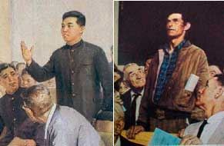
Freedom of Speech, Oil on Canvas, Norman Rockwell, 1943, Norman Rockwell Museum, Stockbridge, MA
North Korean Propaganda Poster!
Notes:
A reminder that imagery supporting the rule of law needs to be aligned with historical Truths
In the poster, this is not a “common man” but an individual who appears to be a party official – note he is dressed the same as another member of the audience – this is not a reflection of an unpopular view being embraced by an audience in disagreement with the speaker’s position – this is an individual advancing a state sanctioned position who is supported by at least one person and who carries the weight of the government to forcibly retaliate against anyone who might dare offer an opposing view
However – even in 1943 America freedom of speech is limited – note that in Rockwell’s painting the man standing is not an African American speaking out against a topic such as Separate but Equal! There is a reminder that America struggles with the interplay between philosophical Truths and historical Truths – in fact, no African Americans are present in the audience! Also – women are barely represented – just one who is partially visible. Does this reinforce what might be suggested in the previous slide/painting?

Slide 8
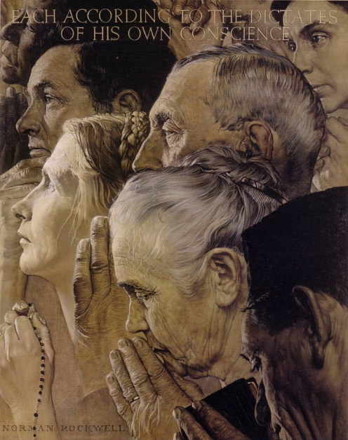
Freedom . . .
Freedom of Worship, Oil on Canvas, Norman Rockwell, 1943, Norman Rockwell Museum, Stockbridge, MA
Notes:
Diverse religions are visually reflected symbolically – hands in prayer, hands holding Rosary Beads, hands holding a Siddur (Jewish prayer book) – Heads are bowed and, with the exception of two, eyes are closed – all symbols of prayer
However – note the individual with his eyes open and hands NOT clasped in prayer but resting on his chin – a visual reflection of thinking. Here may be an atheist – or one who focuses on the power of reason over faith. As Rockwell states “Each According to the Dictates of His own Conscience” – even if his conscience is not aligned with faith in a higher power

Slide 9
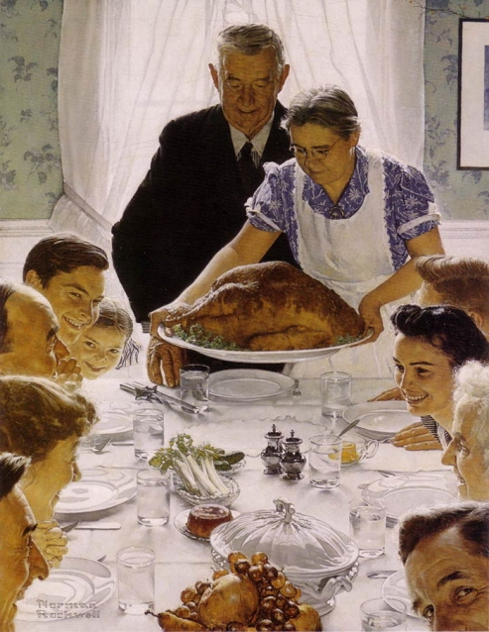
Freedom . . .
Freedom from Want, Oil on Canvas, Norman Rockwell, 1943, Norman Rockwell Museum, Stockbridge, MA
Notes:
What better image, Rockwell thought, to reflect Freedom from Want than a bountiful Thanksgiving dinner, with smiling family members gathered around the table
Rockwell’s cook, Mrs. Wheaton, presents the Turkey – his wife is bottom left, while his mother sits across from her
This image, arguably more than the other 3 in the series, is most directly tied to Roosevelt’s New Deal policies – it advances the ideal that with government directed, planned economies basic wants can be provided for the masses – legislation, the rule of law, and the economy come together through this image and particular Four Freedom.

Slide 10
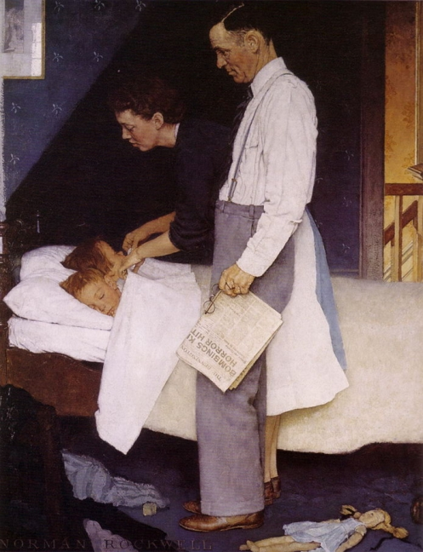
Freedom . . .
Freedom from Fear, Oil on Canvas, Norman Rockwell, 1943, Norman Rockwell Museum, Stockbridge, MA
Notes:
A scene reinforcing security – parents lovingly tuck in their children – safe in their beds under the watchful eyes of their parents.
However – the newspaper in the father’s hand references the war in Europe, specifically the bombings of England
The light in the background has been suggested to allude to European cities on fire – the white shirt and white sheets could suggest purity – and this is made stronger and more evident through Rockwell’s use of a shadow on the wall – this darkness allows the white sheet/pillows, apron, newspaper, and shirt to stand out – it also possibly alludes to the war in the background. Similarly, the doll laying in the foreground suggests the death and destruction in Europe – a broken body laying on the ground. The rule of law is ultimately what is at stake as the war unfolds in Europe and the Pacific Theaters – only by defending the rule of law and defeating oppressive tyrannies can children everywhere sleep peacefully.
One other point in reference to gender, again we find the father tied to the public sphere through his holding the newspaper related to the war and the mother being the one physically, in a nurturing posture, interacting with the children – tying her to the private/domestic sphere.
The Pioneer Suspender Company noted that Rockwell meticulously and accurately portrays the father wearing their suspenders, thus, as the company pointed out, he had another freedom from fear – freedom from fear of his pants falling down as they were secured by their reliable product!

Slide 11
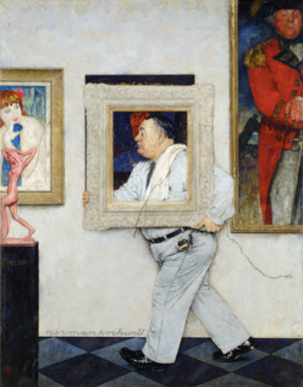
Framed, Oil on Canvas, Norman Rockwell, ca. 1946, Taubman Museum of Art, Roanoke, VA
Notes:
This is the 2nd in a series of 3 paintings Rockwell did where works in an art museum/gallery come to life
Comical work as a “common man,” a museum worker, carries a frame and wire through a gallery in a museum
Works from the Renaissance, 18th c., and 19th c. are hung on the wall, while a modern, early 20th c. sculpture, is present in the foreground
Arguably, Rockwell elevates the common man – an everyman – to an equal status of those pictured around him.
Historically, portraiture was tied to those of means – those who could afford to have their images preserved through painting
Note the British officer – he looks down, literally, at the museum worker – this officer would have been, in all likelihood, a second or third son in the aristocracy – due to primogeniture, his oldest brother would have inherited land – it was not uncommon for parents of second, third, and so on sons to have bought those sons a commission in the military – paid for them to be officers so they could make a name for themselves. This officer was part of the elite – and he does not like that this common everyman is now celebrated through portraiture!
Similarly, the Renaissance figure behind the everyman stares at him with disdain
Portraiture allows the everyman to be positioned as an equal with the two aristocrats – which they apparently do not like based on their expressions
Portraiture elevates him to equal status while his being tied to modern works of art suggests that this ideal (equality) is anything but outdated and antiquated – something that arguably the notions of elitism and hierarchy are as the aristocrats are held in place through their frames
Overall, Framed celebrates the foundation upon which the rule of law must rest – that “all men are created equal” and are entitled to equal protection under the law

Slide 12
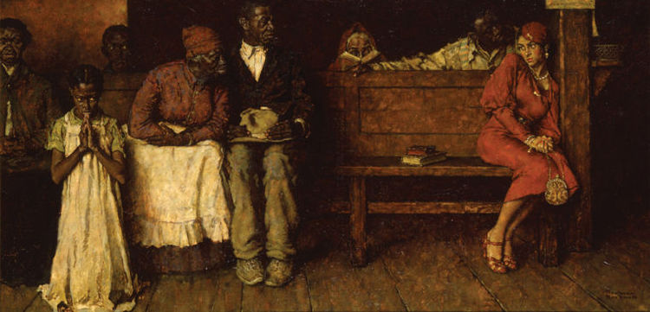
Love Ouanga, Oil on Canvas, Norman Rockwell,1936
Norman Rockwell’s America™, © 2012 Curated and organized by The National Museum of American Illustration, Newport, RI, www.americanillustration.org, and American Illustrators Gallery, NYC, www.americanillustrators.com Special to the News-Aegis
Notes:
First and only illustration containing only black characters.
Created to accompany a short story by Kenneth Perkins, a story which was a retelling of La Traviata with a happy ending.
Illustration foreshadows racially charged issues that Rockwell would address in his later work.
OVERVIEW OF STORY:
1. Spice – unwed mother, “light-skinned” African-American in love with son of a wealthy, educated political boss of the A-A community in New Orleans
2. Lover’s father uses his political power to have Spice declared an unfit mother and orders her expelled from the city as an undesirable person
3. Visits a local black congregation that combines Christianity and the old was – voodoo – for help in getting her son back
4. Local voodoo priestess casts a spell on the father, but Spice has a change of heart and warns him by making him believe she has the power to remove the evil Ouanga
5. Her “love Ouanga” works and the father sees that her son is returned to her and she and her lover are reunited
THE PAINTING:
Rockwell’s characters are “real” people not the stereotypes typical of art of the period
Setting is the dramatic moment when Spice interrupts the black congregation’s meeting
Child at prayer, woman reading from her Bible – all eyes are on Spice cowering in the corner of the front bench
Because of her lighter skin and “city gal,” “dressed like white folks” appearance, the congregants view her with suspicion
Spice wears a red dress – a “scarlet woman” – bedecked with lots of jewelry
Note contrast of skin color dark congregants vs. lighter Spice
Note clothing: Spice in red dress, wearing lots of jewelry = scarlet woman; congregants wear everyday clothes with white apparel pulling our eyes toward them = simple folk pure of heart
MESSAGE:
Tolerance and intolerance: Spice’s relationship with the congregants – initially shunned
Prejudice is not confined to a single race: The juxtaposition of the white dress, white apron, and white shirt to Spice’s red dress and sense of fear/shame suggest the attitude expressed in the story: Spice is a “high-toned city gal” “dressed like white folks”
Like many of the works he will complete later in his career, Rockwell begins to describe the complex social issues that divide us not just in black and white terms

Slide 13
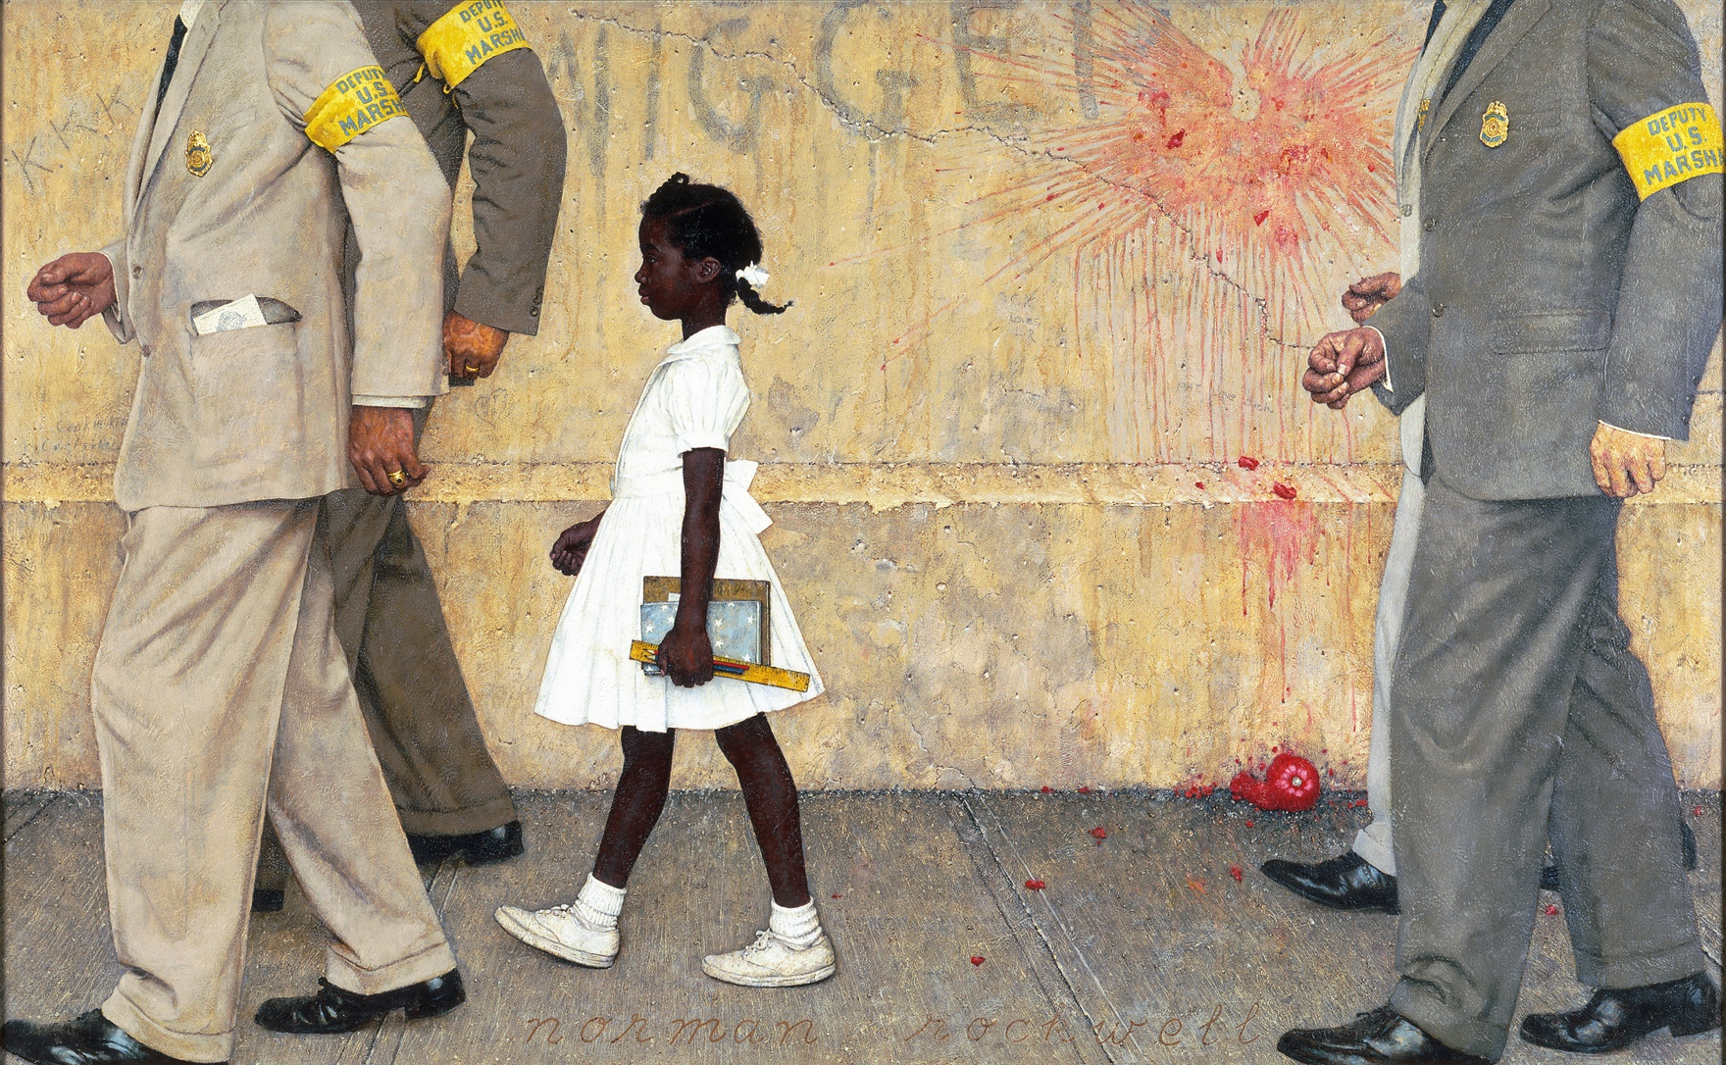
The Problem we all Live with, Oil on Canvas, Norman Rockwell, 1964, Norman Rockwell Museum, Stockbridge, MA
Notes:
HISTORY:
One of his greatest paintings
Left Saturday Evening Post to work for Look Magazine in May 1963 – felt liberated and free to express himself openly about current social issues:
1. March on Washington
2. Letter from The Birmingham Jail
3. Medgar Evers murder
4. Bombing of the 16th Street Baptist Church in Birmingham
HISTORICAL BACKGROUND:
1954: Brown v. Board of Education decision
1956: After numerous delays, Judge Skelly Wright orders New Orleans schools to begin desegregation
1960: Continued delay in NO force Judge Wright to create a plan for integrating the schools beginning with 1st grade
New Orleans BOE devised test for students attempting to exclude African-American children
Ruby Bridges and three other children passed the test and were admitted, making them the first A-A students to integrate the NO school system
4. Nov. 14, 1960 – The first day:
Four federal marshals escort Ruby to William Frantz ES
Taunted and threatened by crowds of angry white spectators
One woman threatened to poison her
Another brought a small coffin containing a black doll
Racially charged invectives
Spent first day sitting in principal’s office because white teachers and students walked out
Eventually, teacher Barbara Henry, a white teacher who had moved to NO from Boston, agreed to teach Ruby
Repercussions:
White students eventually returned,
Barbara Henry lost her job,
The federal marshals vanished,
No one talked about the events during the following years, and
Ruby Bridges walked to school alone
THE PAINTING:
Focal point is Ruby Bridges: starched white dress, white shoes and socks, and the white ribbon in her hair; grips school supplies in left hand
Marshals are headless, anonymous representatives of the government marching in cadence – NOTE: Ruby is out of step, leading with her right foot
Ruby seems about to step on the heels of the marshals before her – in a hurry to get to school
Marshal Charles Burks recalled later that “She just marched along like a little trooper.”
Background: Tomato thrown against wall (perhaps foreshadows the blood spot in Murder in Mississippi); the racially-charged graffiti
The background ugliness reflects the intolerance of the period
CONCLUDING NOTES:
One of Rockwell’s friends mentored Robert Coles, a child psychologist who treated Ruby and other A-A students who suffered emotional trauma as a result of the experiences they endured
John Steinbeck writes an eye-witness account of the events in NO in Travels with Charlie, noting how the “bestial and filthy and degenerate words” of the “demoniac humans” made him feel “helpless.”
Rockwell’s response to negative reactions to this painting:
“For 47 years, I portrayed the best of all possible worlds – grandfathers, puppy dogs – things like
that. That kind of stuff is dead now, and I think it is about time.”

Slide 14
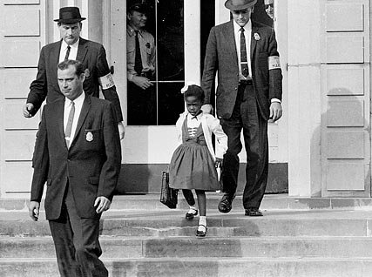
Ruby Bridges Leaving School, Associated Press Photo, 1960

Slide 15
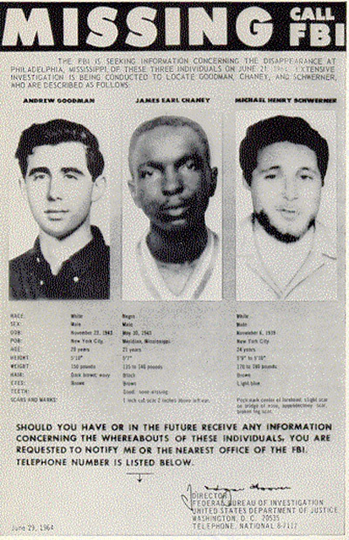
MURDER IN MISSISSIPPI
Official FBI “missing” bulletin for Andrew Goodman, James Chaney, and Michael Schwerner dated June 29, 1964
Notes:
HISTORICAL CONTEXT: FREEDOM SUMMER OF 1964
Civil Rights activists went to Mississippi to establish “Freedom Schools” for A-A children and to register voters (1890 MS Constitution and subsequent state and local laws made it nearly impossible for black citizens to vote)
June 21, 1964: The three young men disappeared, murdered by members of the local KKK and abetted by the local sheriff’s office
August 8, 1964: Their bodies were located buried in an earthen dam – they had been beaten and shot (one body [Andrew Goodman?] suggested that the victim may have been alive at the time of the burial)
State authorities refused to prosecute the accused
1967: 18 defendants prosecuted in federal court on charges of violating the men’s civil rights – seven were convicted and given sentences ranging from 3-7 years
2005: Edgar Ray Killen convicted of planning the abduction and murders; sentenced to three consecutive 20 year terms; still in prison at 91 and still contending that he is a “political prisoner.”
NOTE: While searching for the missing Goodman, Chaney, and Schwerner, law enforcement officials and Navy divers discovered the remains of two civil rights activists missing since May 1964 and the bodies of six black men whose disappearance was known only to their local communities.
The brutal murders outraged the nation and along with other atrocities, led to the passage of the Civil Rights Act of 1964 and the Voting Rights Act of 1965

Slide 16
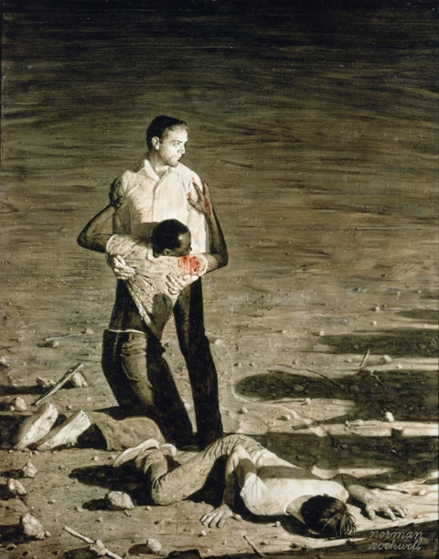
Murder in Mississippi, Oil on Canvas, Norman Rockwell, 1965, Norman Rockwell Museum, Stockbridge, MA
Notes:
HISTORY OF THE PAINTING:
Began work in June of 1964 after reading and hearing about the event
Set aside other commissions to concentrate solely on this work – research, study sketches, charcoal drawings, etc.
One of the study sketches was used to accompany a one-page article entitled “Southern Justice” written by Charles Morgan for Look Magazine, June 29, 1965
THE PAINTING:
Setting:
Barren, isolated, desert-like location with a few rocks and sticks strewn about
Night: darkness shrouds the background except for the vehicle headlights or torches casting bright light on the three victims at the center of the scene
Images:
Focal point = Michael Schwerner supporting the wounded James Chaney and Andrew Goodman prostrate on the ground, appearing to push himself up
Light on the white shirts of the three activists suggests their innocence in the face of the dark forces cast by the shadows on the ground
NOTE: Red blood stain on Chaney’s shirt and Schwerner’s defiant gaze at the unseen men to the right – the number of shadows indicates the young men are clearly out-numbered
Color scheme: Rockwell chose to use the sepia tones of earlier years, giving the painting brown, tea-stained look, thus causing the bright light on the shirts and the blood spot to be even more noticeable
THE MESSAGE:
The civil rights activists represent the principles embedded in the ROL: freedom of speech and expression, freedom from fear, access to justice, equal education, and the right to vote
The hidden Klansmen represent the kind of tyranny that would oppress and deny the “essential human rights” all people deserve
In the end, Murder in Mississippi may be one of Rockwell’s best expressions of the ROL stated simply in the juxtaposition of the lighted and doomed activists and the dark shadows of even darker forces that would destroy the ROL

Slide 17
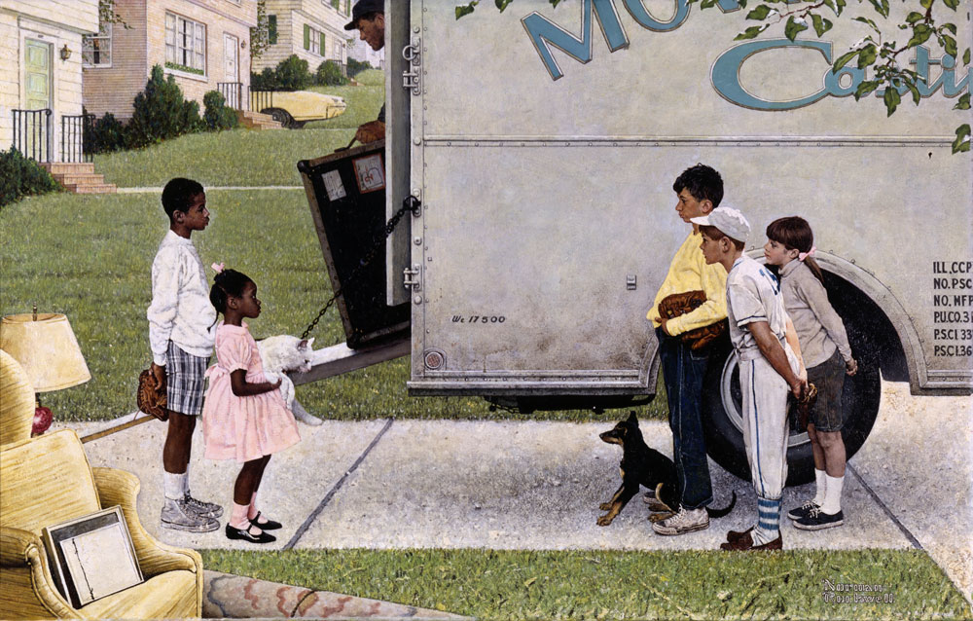
New Kids in the Neighborhood, Oil on Canvas, Norman Rockwell, 1967, Norman Rockwell Museum, Stockbridge, MA
Notes:
BACKGROUND:
Portrays integration of Chicago’s Park Forest community; illustration for article entitled “Negro in the Suburbs”
Simpler, less complex style but with easily recognizable Rockwellian motifs
THE PAINTING:
Simple scene of neighborhood children eyeing one another with simple curiosity
Boys hold baseball gloves and one of the white boys is dressed in his uniform : Why baseball? America’s game
The girls each have pink ribbons in their hair
Both sets of children own pets
This imagery conveys a sense of youthful innocence and suggests that their mutual interests will have them playing together soon
Rockwell often used children as images of neutrality, nonjudgmental observers of the world
Tension in the Scene: For all of the innocence the scene may portray, there is tension within the scene
Cat and dog
The expanse of concrete driveway between the children
The adult peering through the curtains of the pink house
Tension suggests that while the children may get along, it will be more difficult for adults to reconcile differences: forces us to consider the larger slate of societal and democratic issues still with us
Conclusion:
Ruby Bridges: “None of us knows anything about disliking one another when we come into the world. It is something that is passed on to us.”
Abraham Lincoln: “Teach the children so that it will not be necessary to teach the adults.”

Slide 18
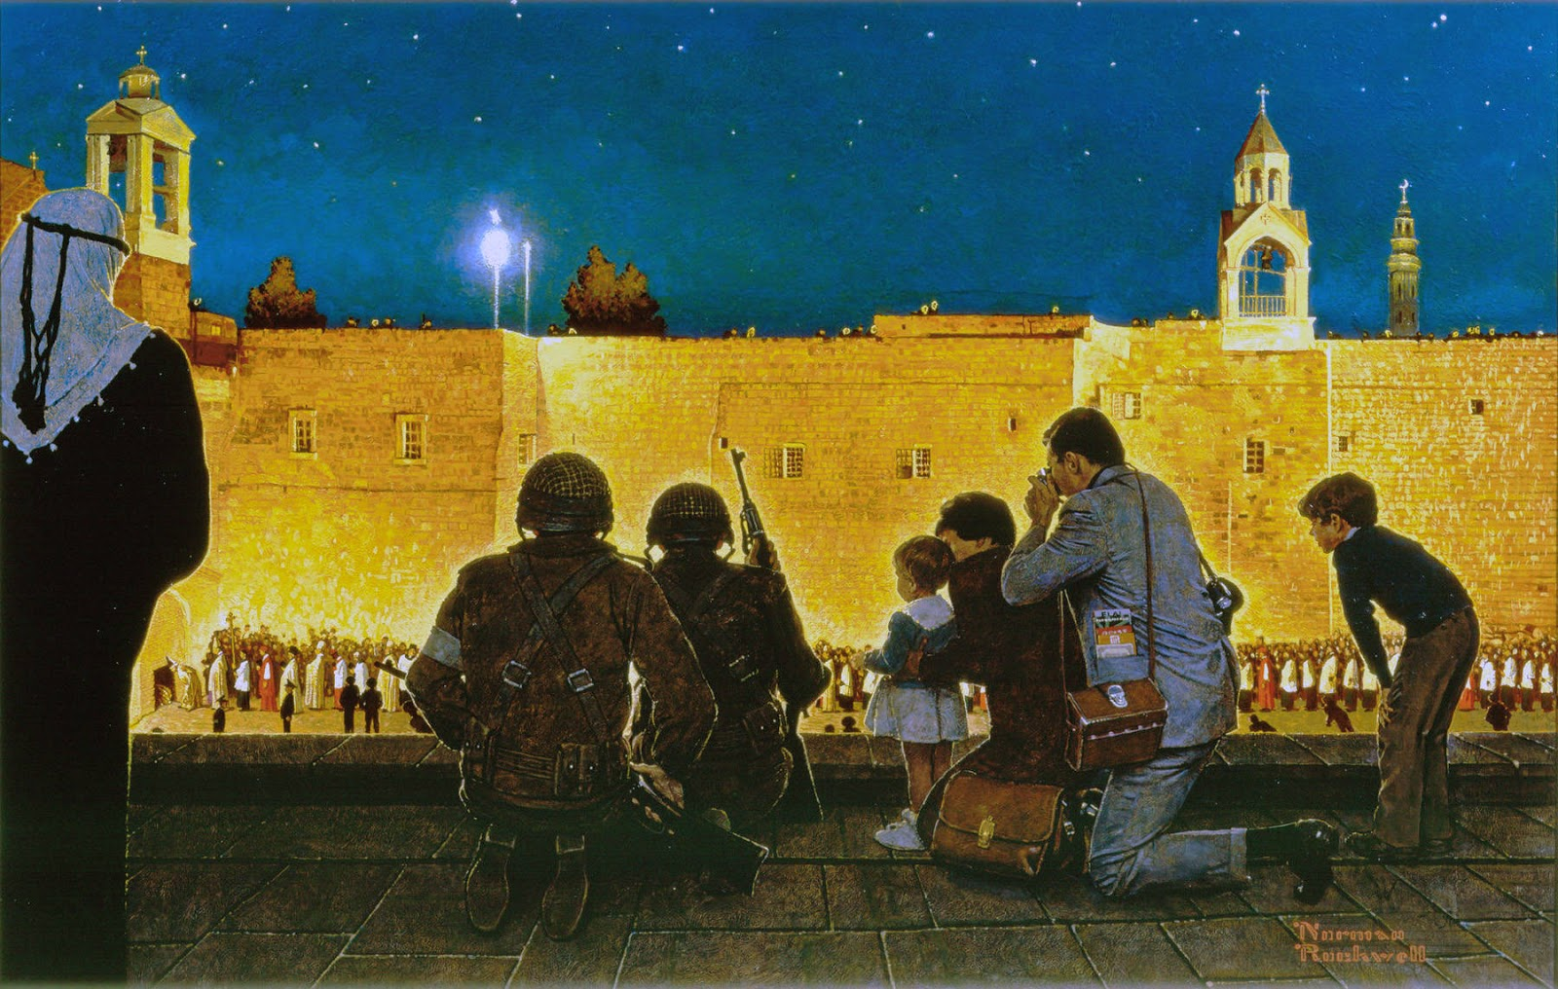
Christmas Eve in Bethlehem, Oil on Canvas, Norman Rockwell, 1970, Norman Rockwell Museum, Stockbridge, MA
Notes:
SETTING: St Katherine’s Basilica at the Church of the Nativity (527-565 A.D.)
COMPOSITION:
Three distinct levels to painting:
Roof-top viewing point
The plaza with the procession of priests and bishops
The sky and opposite roof line – minaret and bell tower
Contrasts:
Arab in keffiyeh, Israeli soldiers, and family of tourists in foreground
Soldiers and children
Arab (Muslim), Israeli (Jews), tourists and religious procession (Christian)
Soldiers in the birthplace of Jesus = tension of war and peace
MESSAGE:
Once again we see Rockwell creating tension in what appears to be a peaceful scene
Touches on those “simple, basic things” such as freedom of conscience,” tolerance, equality; raises an important question for us today:
How do we promote and protect the principles guaranteed by the ROL to everyone when we have grown so diverse?

Slide 19
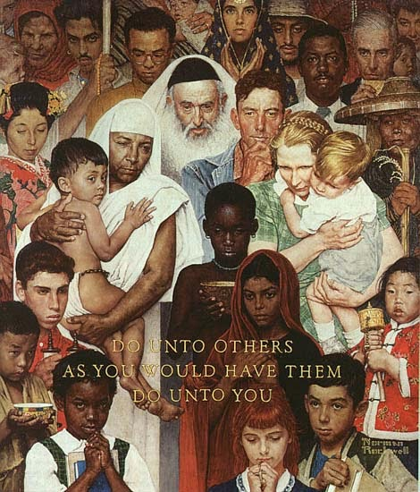
Golden Rule, Oil on Canvas, Norman Rockwell, 1961, Norman Rockwell Museum, Stockbridge, MA
Notes:
Peace Corps, 1966 and Christmas in Bethlehem, 1970
APPROPRIATE TO END WITH THIS PAINTING BECAUSE IT EMPHASIZES THE UNIVERSALITY OF THE ROL
THE PAINTING: Identify images and symbols of different religious beliefs
CONCLUSION: Painting is a visual metaphor for the ROL depicting as it does, not only the universality of the concept, but the basic principles that Roosevelt addressed in his Four Freedoms speech and Rockwell captured in his Four Freedoms paintings and the others we have discussed:
Equality
Freedom
Essential human rights
CONCLUSION:
Norman Rockwell’s body of work reminds us of two important ideas:
The well-known nostalgic, idyllic worlds created in the paintings depict a world that was denied to large segments of American society because the ROL did not apply to them; that world, as Rockwell said, “is dead”;
The other idea we gain from Rockwell’s later paintings is that we can and must learn to change, to be accepting of the diversity around us, to realize that we still have a long way to go to ensure that freedom is available to everyone, that all people have dignity and deserve the guarantees provided by the ROL.

Slide 20
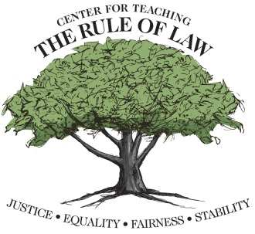
The Center wishes to thank Scott Crawford for his contributions in developing this material.
© Copyright 2017 Center for Teaching the Rule of Law

