Slide 1
GEORGE WASHINGTON: INDISPENSIBLE VISIONARY
This project is financially assisted by a generous grant from the Virginia Law Foundation. The Virginia Law Foundation promotes through philanthropy the rule of law, access to justice and law-related education.
Notes:
1732 - 1799

Slide 2
BACKCOUNTRY SURVEYOR
Whatever He Did He Did Well, Frank Earle Schoonover, 1924.
Gift of J. Thompson Brown, Class of 1902, collection of Virginia Tech.
Notes:
Began as a 16 year-old in 1748; lasted until ca. 1752
THE PAINTING:
Although idealized, the painting depicts the rugged beauty that Washington came to admire as “providence’s favors” and American’s greatest asset:
"Would to God we may have wisdom enough to improve them [the favors of the backcountry]. I shall not rest contented 'till I have explored the Western Country, & traversed those lines . . . which have given bounds to a New Empire.“ (George Washington to Chevalier de Chastellux, October 12, 1783)
His observations as a surveyor “strengthened and deepened his conviction that landownership was the most important factor of colonial development.”
Washington is depicted as a frontiersman, not the formally attired general/political leader we expect
Note: Native American, head bowed in the background: Washington understood what white encroachment meant for the indigenous people, but he felt that they would eventually “consent to our occupying those lands.” (Letter to Wm. Crawford, September 1767)
IMPORTANCE OF SURVEYING:
Although often self-taught, surveyors were among the best-educated men in the colony
Their extensive knowledge of the land, especially the frontier, equipped many surveyors with the tools needed to become successful and rich land speculators
Importance of their unique role in opening the backcountry to settlement
With the English and its ever-increasing governmental regulations facing them to the east, the western backcountry became the hope of new immigrants looking to create homes on property they owned
The requirement for “just and true” surveys guaranteed equal treatment for those seeking to purchase western lands
With legally recognized ownership came the guarantee of personal property rights
Their practical knowledge of the land and political acumen fostered large land companies and individual entrepreneurs to invest in the development of the backcountry lands – stakeout new towns, etc.
IMPORTANCE OF THE FRONTIER:
Promise of social and financial success
Advances in personal property rights
Expansion of the soon-to-be new nation
Security – French and Indian War
Natural beauty and wealth of natural resources
IMPORTANCE TO WASHINGTON’S VISION
Washington’s years as a surveyor and his experiences in the backcountry as a young man had a lasting influence on the future soldier, land speculator, farmer, army commander, political leader, and president
Enabled him to see the harsh living conditions of the settlers struggling to become landowners
A. Story of night spent with settler family: slept on straw pallet with one “blanket with double its Weight of Vermin such as Lice Fleas and I was glad to get up (as soon as the Light was carried from us) I put on my Cloths and Lay as my Companions.” (George Washington, ca. 1749-50?)
B. Exposed him to the ever-present dangers and hardships of the scattered settlers forced to live by their own resourcefulness and self-reliance – nurtured a deep respect for those hardy people and the part they played in the development of the country (similar to his attitude toward the soldiers he would command during the Revolutionary War)
His years on the frontier established a reputation for:
Fairness, justice, and dependability (principles inherent in the rule of law)
Respect for and promotion of personal property rights ( another embedded principle of the rule of law)
4. Rounded out his character, heightened his realistic objectives, and reflected his attention to detail (qualities he needed as President of the Constitutional Convention and later as the nation’s first president)

Slide 3
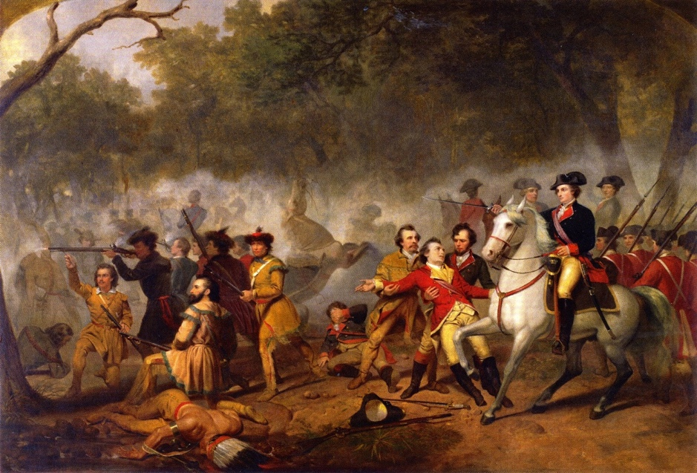
MILITIA HERO
Washington as Captain in the French and Indian War, Junius Brutus Stearns, ca. 1851
Notes:
British officer from 1753 to 1759
Just as the frontier helped Washington enter public service, acquire land, and shape his views on property, it also allowed him access to the ability to make a name for himself as a military leader
Washington proved himself, as depicted here, when Braddock and Washington were ambushed along the Monongahela and Braddock was killed. Washington took command and helped lead a successful retreat, gaining him a strong reputation in Williamsburg, Va’s colonial capital!
Over 500 British troops died – over 400 were wounded – Washington lost two mounts and his coat was riddled with bullet holes
Even hardened British veterans were impressed with Washington’s leadership and coolness under fire

Slide 4
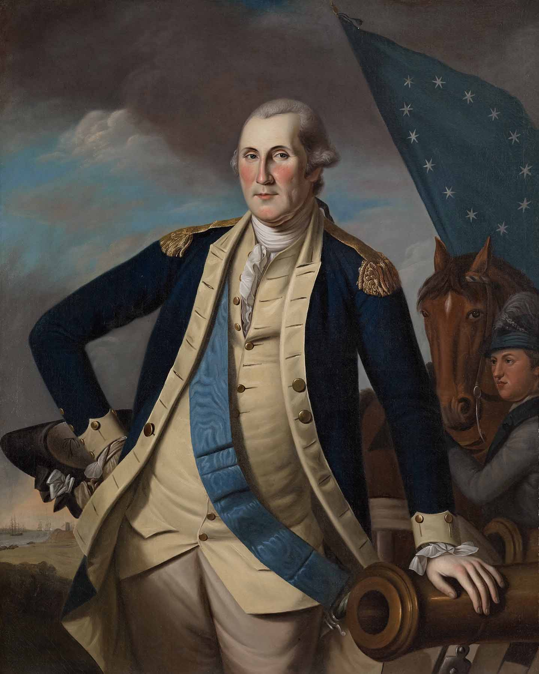
REVOLUTIONARY COMMANDER
Washington at Yorktown, Oil on Canvas, Charles Wilson Peale, ca. 1782
Notes:
1775-1783: Washington’s French and Indian War experience helped him grow as a military commander, with several important lessons learned that helped him find success during the Revolution:
Not to act in haste – not always prudent to fight – embraced Fabian tactics
Work better with civil authorities – he learned from his arguments with Dinwiddie that it was not always best to be so straightforward with civil authority – he needed to work with Congress
“Act” more like a commander – be with his troops, not leading from afar. Banned wine from his table – only visited Mt. Vernon six years after taking command and that was on his way to Yorktown
As for the painting:
Peale’s “casual” depiction of his subject allows Washington to become more of a “common man” and less the “mythic” hero he would become
Peale, along with other artists of his day, believed gazing at models of republican virtue would help viewers become more virtuous themselves
Within this portrait we find an icon of republican virtue, who, building on prior experiences along the Virginia backcountry, is able to do the impossible – defeat a major super power AND, in true republican spirit, give up command and power to return to life as a civilian and citizen.

Slide 5
AMERICAN CINCINNATUS
GEORGE WASHINGTON, JEAN ANTOINE HOUDON, 1785-1791
Located in the Virginia State Capitol Building, Richmond, Virginia
Notes:
Retired his position as Commander of the Continental Army in 1783
Notice Washington’s relaxed yet confident demeanor as he stands, walking stick in hand, looking into the distance as if surveying his property.
Difficult to see in this photo is the missing button at the bottom of his vest, suggesting yet again an informal air – he is the American common man, a farmer.
He rests on a fasces, a bundle of rods with a projecting ax blade used as a symbol of republican authority in ancient Rome – suggesting the new nation’s democratic republican system of government in which citizens elect their government officials, like George Washington.
Behind and resting against the fasces is a plow, symbol of his life as a gentleman farmer, again suggesting Washington’s role as a common citizen willing to serve his country.
Active and innovative farmer: Honorary member of the Philadelphia Society for the Promotion of Agriculture and the English Board of Agriculture
Described as “a knowing farmer, who, Midas like, can convert everything he touches into manure, as the first transmutation towards gold.”
Agriculture’s importance to the young nation: “…in the present state of America, our welfare and prosperity depend upon the cultivation of our lands and turning the produce of them to the best advantage.” (Letter to Samuel Chamberline, 1788)
Across the fasces hangs his sword, a symbol of his willingness to leave his life as gentleman farmer and take up arms as a citizen soldier to defend his republican ideals of the right to property ownership, freedom and liberty.
The American Cincinnatus: Explain classical allusion to Roman statesman/soldier Cincinnatus

Slide 6
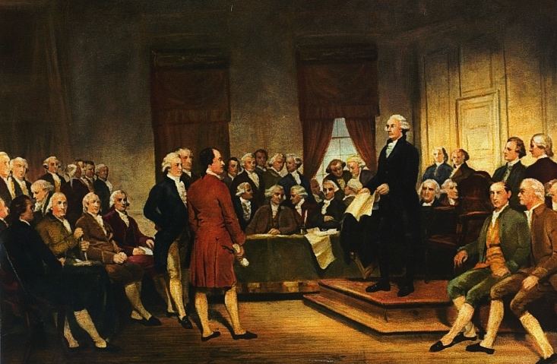
RELUCTANT REPUBLICAN: THE CONSTITUTIONAL CONVENTION
Washington as Statesman at the Constitutional Convention, Junius Brutus Stearns, 1856
Notes:
However, Washington will not play the role of private citizen for long as a constitutional crisis will bring about his involvement in a second American Revolution – a bloodless revolution that will go beyond its authorized scope and not amend the Articles of Confederation but replace this first attempt at self-government with a new Constitution.
Washington serves as the president of the Constitutional Convention:
1787 he is urged out of retirement by his friend James Madison, who brought him “a wheel barrow” full of books on government and political philosophy to prepare him for the Constitutional Convention
While pictured here above all of the other delegates, Washington played a more supportive role at the convention – his presence gave the convention validation and credibility
Washington would become one of the strongest advocates for a strong federal government, while Jefferson would advocate for limited federal power and a states-rights model
This difference of opinion became the tension that has been at the heart of our political system to the present
Washington recognized in his own time that this tension might end in civil war; he was prescient in his conclusion
The struggle continues today as we hear voices calling for less federal government intrusion in our lives, and other voices asking the federal government to do more to help those unable to help themselves and to enact regulations to protect the common good (the environment, health care, financial regulations, regulations of trade and commerce)
The tension also reflects an evolutionary tension within the ROL: the tension between formalist theories (legal positivists) and substantive theories (natural law)
Formal theory of the ROL: Law as primarily and a mechanism consisting of rules and regulations that keep government and society functioning
Substantive theory of the ROL: Law is “primarily a moral instrument” that must adhere to “fundamental principles of justice”

Slide 7
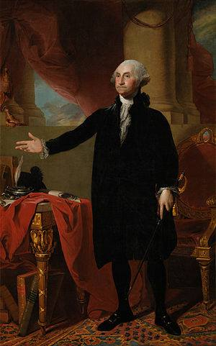
MAN OF VISION
The Lansdowne Portrait, Oil on Canvas, Charles Wilson Peale, 1796
Notes:
President from 1789-1797
Gilbert Stuart painted the Lansdowne portrait toward the end of Washington’s second term as president and as Washington was about to do the unthinkable – for a second time, in true republican and democratic fashion, give up power!
The portrait presents Washington as statesman – this is Washington as president.

Slide 8
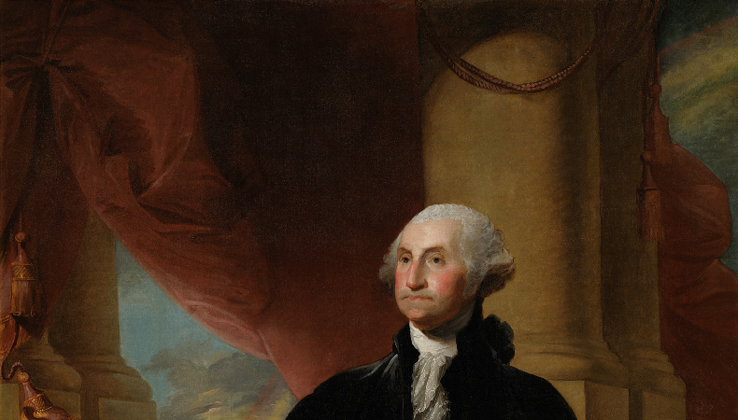
Notes:
However, the symbolism Stuart uses provides a beautiful reflection of Washington’s beliefs about the rule of law.
To the left of Washington are dissipating storm clouds – to his right, a rainbow is evident.
That Stuart includes the rainbow, we find 2 clear references to Noah and the Great Deluge – storm clouds alone could simply suggest political and/or social turmoil, but his including the rainbow, symbolizing the storm has passed, alludes to Noah and the Flood

Slide 9
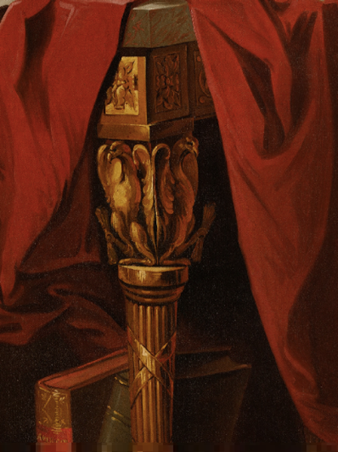
MAN OF VISION
Notes:
Table Legs: Once more we see the symbol of republicanism in the form of legs shaped like the Roman Faces
Washington stands with right arm extended in the direction of the inkwell and quill
With this visual reference to Noah, a third allusion emerges under close examination – the ink well takes on the distinct look and feel of an ark. This is possibly an allusion to Noah’s Ark.
The National Portrait Gallery notes that the inkwell resembles a classical boat design, such as a Roman Corbita, a merchant ship. (Perhaps suggesting the importance of a stable commercial system Washington and the young nation [emphasis mine].
This inkwell strongly alludes to Noah’s Ark – and it has Washington’s family crest, so this could suggest it is “Washington’s Ark”
The National Portrait Gallery notes that the inkwell may refer to the making of laws: “The inkwell and quill may refer to the making of laws and the fact that Washington wrote and signed many important documents in his lifetime…”

Slide 10
“No morn ever dawned more favorably than ours did, and no day was ever more clouded than present. ’”
- Letter to James
Madison, Nov. 5, 1786
Notes:
To Washington it is the rule of law that will protect the republic – the rule of law is the ark that will carry the nation through the storms, trials, and tribulations that it must face.
Through this symbolism, Stuart goes beyond contemporary suggestions that Washington was the Moses of the American people – Stuart suggests that he was also an American Noah.
And within the context of Washington’s observation in 1786 how this new “morn” has dawned – suggesting hope – yet a cloud was hanging over the nation, suggesting a degree of strife that may actually always be present that could undermine this republican experiment. Again, the Ark – the rule of law – will help the nation survive this strife and these clouds.
NOTE TO TEACHER – an interesting discussion with students could center on other Biblical references to “arks” – for example, the use of Noah’s Ark can bring about the connotation of the Ark of the Covenant. In both cases, with the Rainbow and the Ark and the 10 Commandments, housed in the Ark of the Covenant, God enters into a covenant with Noah and Moses respectively – and in essence, the Constitution is a covenant – thus through the concept of “arks,” you can explore with the students the idea of the rule of law as covenants contracts, compacts (The Mayflower Compact), and constitutions – in a word, “agreements” between citizens and government.

Slide 11
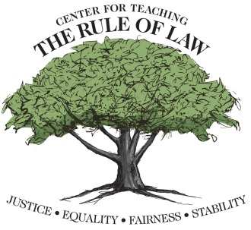
The Center wishes to thank Scott Crawford for his contributions in developing this material.
© Copyright 2016 Center for Teaching the Rule of Law

