Slide 1
GEORGE WASHINGTON: MAN OF VISION, VISIONS OF THE MAN
This project is financially assisted by a generous grant from the Virginia Law Foundation. The Virginia Law Foundation promotes through philanthropy the rule of law, access to justice and law-related education.

Slide 2
THE RULE OF LAW
"The rule of law is the most important political ideal today, yet there is much confusion about what it means and how it works."
Brian Tamanaha
DEFINITION:
Civil society based on the core beliefs of:
Consent of the Governed
Limited Government
Obedience to the Law
Thereby guaranteeing to its citizens:
Fairness Stability
Equality Certainty
Justice Security
Trust Peace
Notes:
It is the rule of law that is the foundation for representative republican democracy, constitutional government, a stable economic system, and the ideals and institutions associated with civil society.

Slide 3
"Great nations write their autobiographies in three manuscripts – the book of their deeds, the book of their words and the book of their art." – John Ruskin
Notes:
Note: Here is an opportunity to remind students that history is more than words on a page. Our nation’s history – its ideals, accomplishments, and failures – surrounds us in the art, architecture, sculpture, films, cartoons, music, and popular culture that we experience daily. This PPT on George Washington will, hopefully, help them appreciate this idea and encourage them to look for other examples of how history is learned outside the classroom as well as in the textbooks they study in the classroom.

Slide 4
BACKCOUNTRY SURVEYOR
Whatever He Did He Did Well, Frank Earle Schoonover, 1924.
Gift of J. Thompson Brown, Class of 1902, collection of Virginia Tech.
Notes:
THE PAINTING:
Although idealized, the painting depicts the rugged beauty that Washington came to admire as “providence’s favors” and American’s greatest asset:
"Would to God we may have wisdom enough to improve them [the favors of the backcountry]. I shall not rest contented 'till I have explored the Western Country, & traversed those lines . . . which have given bounds to a New Empire.“ (George Washington to Chevalier de Chastellux, October 12, 1783)
His observations as a surveyor “strengthened and deepened his conviction that landownership was the most important factor of colonial development.”
Washington is depicted as a frontiersman, not the formally attired general/political leader we expect
Buckskins and fringed boots
Powder horn and leather satchel hanging at his side
Tools of his trade: surveyors siting compass and chain, maps scattered on ground, notes and quill pen to record data
Note his posture: Firm, erect, focused on the distance; clearly a man with a purpose
The pose of a man at work, the frontier attire, and the wilderness setting set Washington apart from illustrious contemporaries of college-educated, well-read lawyers and landed gentry
Note: Native American, head bowed in the background: Washington understood what white encroachment meant for the indigenous people, but he felt that they would eventually “consent to our occupying those lands.” (Letter to Wm. Crawford, September 1767)
IMPORTANCE OF SURVEYING:
Although often self-taught, surveyors were among the best-educated men in the colony
Their extensive knowledge of the land, especially the frontier, equipped many surveyors with the tools needed to become successful and rich land speculators
By the time of his death, Washington had acquired over 52,000 acres in VA, MD, PA, NY, KT, and the Ohio Valley (At one point, he is said to have possessed nearly 70,000 acres)
He also owned property in Winchester, Berkley Springs, Alexandria, and DC
Surveyors held official positions that required testing and a license
Washington passed his test and received his license as Culpeper County Surveyor from the College of William and Mary in 1749
Those seeking to purchase land acquired a survey warrant from the land office that instructed the surveyor to make a “just and true” survey of the land, thereby officially determining and limiting its boundaries – thus the surveyor’s work, maps, charts, etc., became legally recognized documents
Their official position also brought them into constant contact with large land owners and the political establishment, thus enabling them to prosper both financially and politically
Example: Washington spent three years as part of the surveying crew tasked with surveying Lord Fairfax’s western lands
Trip marked beginning of life-long relationship with the Fairfax family that introduced the young Washington the elite of VA society
Importance of their unique role in opening the backcountry to settlement
With the English and its ever-increasing governmental regulations facing them to the east, the western backcountry became the hope of new immigrants looking to create homes on property they owned
The requirement for “just and true” surveys guaranteed equal treatment for those seeking to purchase western lands
With legally recognized ownership came the guarantee of personal property rights
Their practical knowledge of the land and political acumen fostered large land companies and individual entrepreneurs to invest in the development of the backcountry lands – stakeout new towns, etc.
IMPORTANCE OF THE FRONTIER:
Promise of social and financial success
Frontier provided the setting for a new culture to emerge, one based more on merit rather than on family heritage; led to an American society where a person could acquire wealth through initiative and accomplishment
Washington’s idea for the C & O Canal to link the ports below the Potomac fall line with the growing commercial centers to the west of the fall line
Advances in personal property rights
Expansion of the soon-to-be new nation
Security – French and Indian War
Natural beauty and wealth of natural resources
IMPORTANCE TO WASHINGTON’S VISION
Washington’s years as a surveyor and his experiences in the backcountry as a young man had a lasting influence on the future soldier, land speculator, farmer, army commander, political leader, and president
His years on the frontier established a reputation for fairness, justice, and dependability (principles inherent in the rule of law)
Enabled him to see the harsh living conditions of the settlers struggling to become landowners
Story of night spent with settler family: slept on straw pallet with one “blanket with double its Weight of Vermin such as Lice Fleas and I was glad to get up (as soon as the Light was carried from us) I put on my Cloths and Lay as my Companions.” (George Washington, ca. 1749-50?)
Exposed him to the ever-present dangers and hardships of the scattered settlers forced to live by their own resourcefulness and self-reliance – nurtured a deep respect for those hardy people and the part they played in the development of the country (similar to his attitude toward the soldiers he would command during the Revolutionary War)
Rounded out his character, heightened his realistic objectives, and reflected his attention to detail (qualities he needed as President of the Constitutional Convention and later as the nation’s first president)
Fostered respect for and promotion of personal property rights ( another embedded principle of the rule of law)

Slide 5
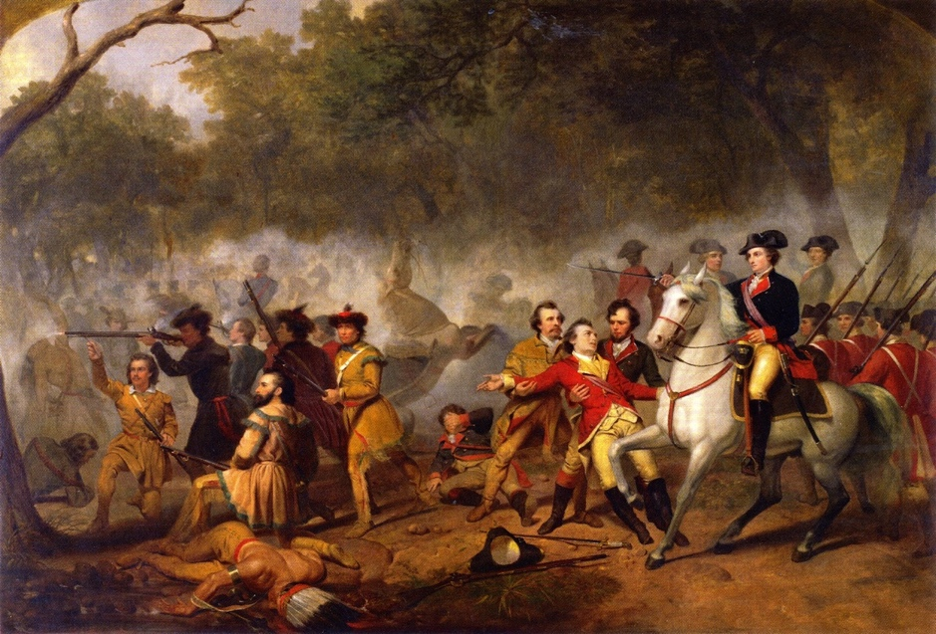
MILITIA HERO
Washington as Captain in the French and Indian War, Junius Brutus Stearns, ca. 1851
Notes:
Just as the frontier helped Washington enter public service, acquire land, and shape his views on property, it also allowed him access to the ability to make a name for himself as a military leader
First met disaster at Ft. Necessity – returned embarrassed – left the Virginia Regiment due to its being reorganized, which would have resulted in Washington being demoted
He returned to the VA Regiment as a volunteer, without pay, with Braddock’s arrival in early 1755 - As he told his brother he sought command of the VA Regiment so that he might “gain by it” – his service could lead to economic, social, and even political mobility
Washington proved himself, as depicted here, when Braddock and Washington were ambushed along the Monongahela and Braddock was killed. Washington took command and helped lead a successful retreat, gaining him a strong reputation in Williamsburg, Va’s colonial capital!
Over 500 British troops died – over 400 were wounded – Washington lost two mounts and his coat was riddled with bullet holes
Even hardened British veterans were impressed with Washington’s leadership and coolness under fire

Slide 6
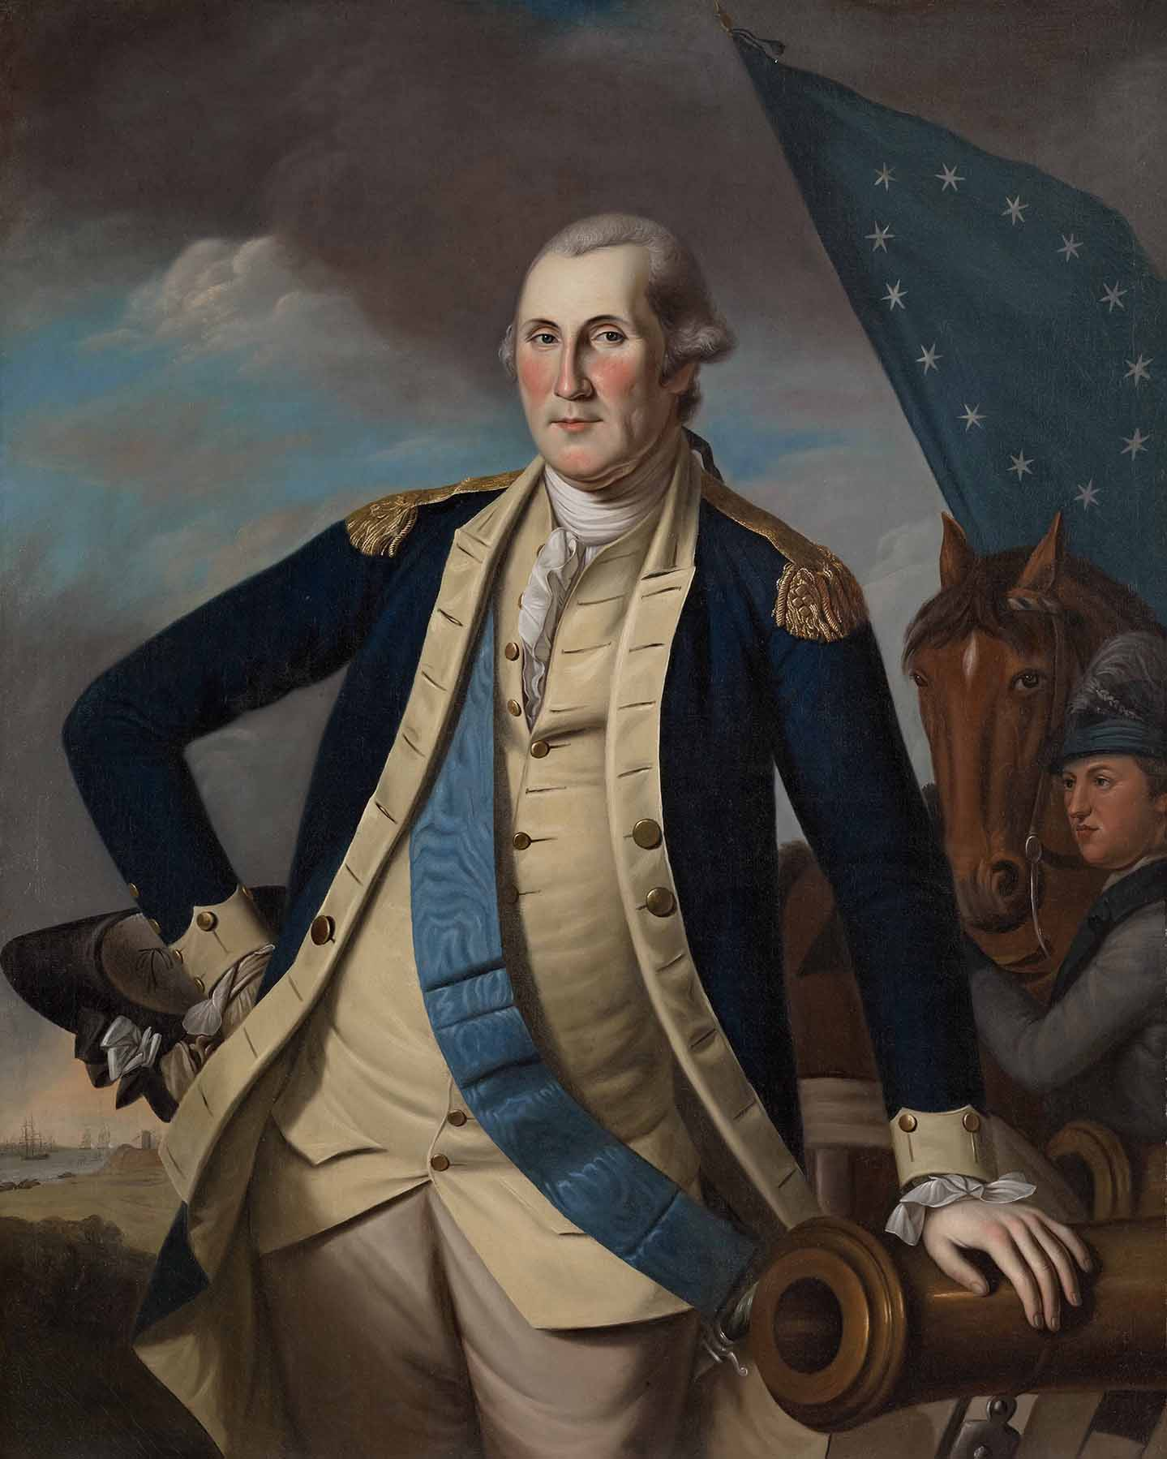
REVOLUTIONARY COMMANDER
Washington at Yorktown, Oil on Canvas, Charles Wilson Peale, ca. 1782
Notes:
Washington’s French and Indian War experience helped him grow as a military commander, with several important lessons learned that helped him find success during the Revolution:
Not to act in haste – not always prudent to fight – embraced Fabian tactics
Work better with civil authorities – he learned from his arguments with Dinwiddie that it was not always best to be so straightforward with civil authority – he needed to work with Congress
“Act” more like a commander – be with his troops, not leading from afar. Banned wine from his table – only visited Mt. Vernon six years after taking command and that was on his way to Yorktown
As for the painting:
Peale over relied on ovals for heads and torsos, thus losing, to some degree, individuality – it allows, in this case, Washington to become more of a “common man” as the individuality is lost through the use of ovals.
Peale’s subjects tend to be in the foreground, almost intruding upon the viewer’s space – did this to clearly and forcibly demonstrate republican virtue believed gazing at models of republican virtue would help viewers become more virtuous themselves
Within this portrait we find an icon of republican virtue. We find a man who, building on prior experiences along the Virginia backcountry, is able to do the impossible – defeat a major super power AND, in true republican spirit, give up command and power to return to life as a civilian and citizen.

Slide 7
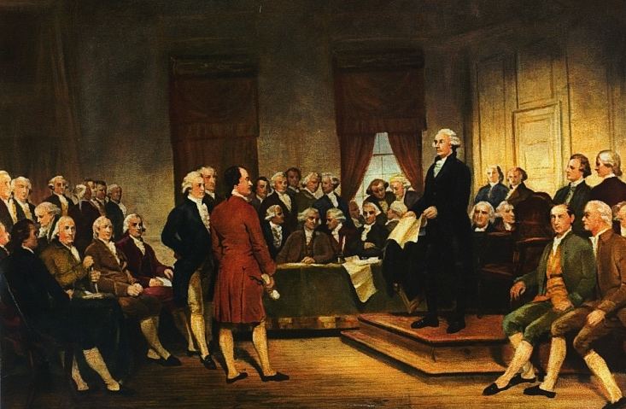
RELUCTANT REPUBLICAN: THE CONSTITUTIONAL CONVENTION
Daniel Carroll
George Washington
John Dickenson
George Read
James Madison
Alexander Hamilton
Rufus King
Nathaniel Gorham
Washington as Statesman at the Constitutional Convention, Junius Brutus Stearns, 1856
Notes:
However, Washington will not play the role of private citizen for long as a constitutional crisis will bring about his involvement in a second American Revolution – a bloodless revolution that will go beyond its authorized scope and not amend the Articles of Confederation but replace this first attempt at self-government with a new Constitution.
Washington serves as the president of the Constitutional Convention:
While pictured here above all of the other delegates, Washington played a more supportive role at the convention – his presence gave the convention validation and credibility
However, according to Madison’s very detailed notes on the proceedings of the convention, Washington only spoke once – on the last day when an issue about representation came up. Nathaniel Gorham of MA advanced the motion that rather than each state having 1 representative for every 40,000 persons, each state should have 1 Rep for every 30,000 persons.
Madison notes that Rufus King, MA, and Daniel Carroll, MD, seconded this motion. At that point:
“When the President rose, for the purpose of putting the question, he said, that although his situation had hitherto restrained him from offering his sentiments on questions depending in the House, and, it might be thought, ought now to impose silence on him, yet he could not forbear expressing his wish that the alteration proposed might take place. It was much to be desired that the objections to the plan recommended might be made as few as possible. The smallness of the proportion of Representatives had been considered, by many members of the Convention an insufficient security for the rights and interests of the people. He acknowledged that it had always appeared to himself among the exceptionable parts of the plan; and late as the present moment was for admitting amendments, he thought this of so much consequence, that it would give him much satisfaction to see it adopted.”
With that, there was no opposition to the proposed amendment, and the 1/30,000 representation ratio was passed and added to the Constitution
Also of note are James Madison, “Father of the Constitution” and Alexander Hamilton – (does he hold his Hamilton Plan?)
In all, 39 signers are pictured – but only 38 were actually present at the signing. John Dickenson could not be present but wanted to make sure his name was on the document. George Read, DE, signed his name for him.

Slide 8
PLANTER OF HIS OWN VINE AND FIG TREE
All images from www.mountvernon.org ©2016 Mount Vernon Ladies’ Association. All Rights Reserved.
Notes:
As architect of his beloved Mount Vernon, Washington became the planter of his own “vine and fig tree,” a biblical reference to the peace and tranquility that was the center of his life.
Over the course of his life Washington would turn a simple farm house into one of the most distinguished and iconic homes in America just as he used his skills too help construct a nation built on the rule of law and the democratic ideas and institutions it supports.
Built ca. 1735 as a one and half story farm house, Washington first leased the house and farm at Little Hunting Creek Plantation from his older half-brother Lawrence in 1754 and later inherited it – now know as Mount Vernon – in 1761
Named for Admiral Edward Vernon of the British Navy, Lawrence Washington’s commander
By 1758, Washington had begun renovations that would expand the house dramatically:
Two-stories with one-story additions to the north and south ends
Addition of the elaborate walnut central staircase
“Rustication” of exterior (Sand mixed in the paint to give the appearance of a masonry exterior)
But Washington’s vision for his home was not yet realized.
Between 1774 and 1775, Washington would undertake a major expansion of Mount Vernon that would continue for nearly a decade:
1777: Adds pediment to west façade and constructed the two-story, 90 foot piazza on the east façade – Washington would use the piazza as an exercise area in winter
1783: Began construction of the Cupola
1787: Commissions Joseph Rakestraw to create a metal “Dove of Peace” weathervane to top the cupola:
“…have a bird…with an olive branch in its Mouth…” (G.W.)
Challenges of Washington’s 18th century vision:
Personally involved in each renovation project – design, construction, and decoration
Proposed innovative and practical design features – gleaned from his reading or architectural journals and correspondence with leading architects
Issue of symmetry: 18th century – The Age of Enlightenment – an age built on the ideas of balance, symmetry, and harmony of parts
Conversion to two stories and the addition of the central staircase created an asymmetrical western façade (notice irregular spacing between windows and door
To create sense of symmetry, Washington suggested addition of false windows on the left side of the second story
Addition of the pediment to the west entrance further disguises the “disharmony” of the west face
Final attempt to provide symmetry came with the addition of the cupola – the structural center of the mansion
18th century “air conditioning” – cupola’s windows when opened created an updraft that drew warm air out of lower rooms through the central stairway, thus cooling the mansion
Communications: Series of bells attached inside and outside house to summon servants and slaves
So what?
Washington’s eye for symmetry and balance in architectural construction found its reflection in his contributions to “building” America’s Constitution
His sense of practicality and functional utility also contributed to the Constitution
His sense of home – pride and love – reveal him to be a man who saw himself as a planter, farmer, builder and citizen first; he was a public servant only when called upon to serve

Slide 9
AMERICAN CINCINNATUS
GEORGE WASHINGTON, JEAN ANTOINE HOUDON, 1785-1791
Located in the Virginia State Capitol Building, Richmond, Virginia
Notes:
Notice Washington’s relaxed yet confident demeanor as he stands, walking stick in hand, looking into the distance as if surveying his property.
Difficult to see in this photo is the missing button at the bottom of his vest, suggesting yet again an informal air – he is the American common man, a farmer.
He rests on a fasces, a bundle of rods with a projecting ax blade used as a symbol of republican authority in ancient Rome – suggesting the new nation’s democratic republican system of government in which citizens elect their government officials, like George Washington.
Behind and resting against the fasces is a plow, symbol of his life as a gentleman farmer, again suggesting Washington’s role as a common citizen willing to serve his country.
Active and innovative farmer: Honorary member of the Philadelphia Society for the Promotion of Agriculture and the English Board of Agriculture
Described as “a knowing farmer, who, Midas like, can convert everything he touches into manure, as the first transmutation towards gold.”
Agriculture’s importance to the young nation: “…in the present state of America, our welfare and prosperity depend upon the cultivation of our lands and turning the produce of them to the best advantage.” (Letter to Samuel Chamberline, 1788)
Across the fasces hangs his sword, a symbol of his willingness to leave his life as gentleman farmer and take up arms as a citizen soldier to defend his republican ideals of the right to property ownership, freedom and liberty.
The American Cincinnatus: Explain classical allusion to Roman statesman/soldier Cincinnatus

Slide 10
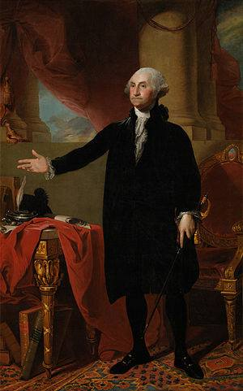
MAN OF VISION
The Lansdowne Portrait, Oil on Canvas, Charles Wilson Peale, 1796
Notes:
Gilbert Stuart painted the Lansdowne portrait toward the end of Washington’s second term as president and as Washington was about to do the unthinkable – for a second time, in true republican and democratic fashion, give up power!
The portrait presents Washington as statesman – this is Washington as president.

Slide 11
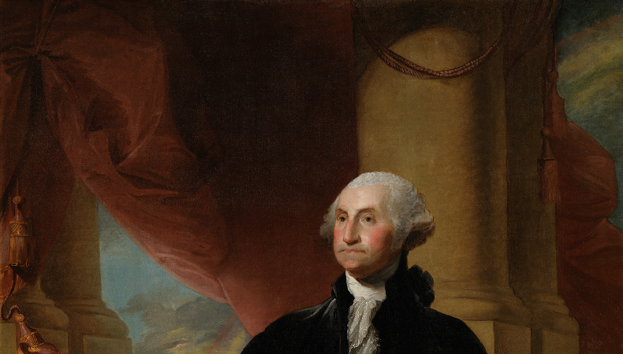
Notes:
However, the symbolism Stuart uses provides a beautiful reflection of Washington’s beliefs about the rule of law.
To the left of Washington are dissipating storm clouds – to his right, a rainbow is evident.
That Stuart includes the rainbow, we find 2 clear references to Noah and the Great Deluge – storm clouds alone could simply suggest political and/or social turmoil, but his including the rainbow, symbolizing the storm has passed, alludes to Noah and the Flood

Slide 12
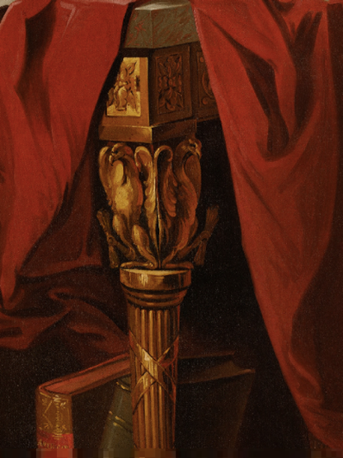
MAN OF VISION
Notes:
With this visual reference to Noah, a third allusion emerges under close examination – the ink well takes on the distinct look and feel of an ark. This is possibly an allusion to Noah’s Ark.
The National Portrait Gallery notes that the inkwell may refer to the making of laws:
“The inkwell and quill may refer to the making of laws and the fact that Washington wrote and signed many important documents in his lifetime The two documents on the table could be Stuart’s way of symbolizing Washington’s role in important documents, but Stuart does not portray any specific document, such as the recently signed Jay’s Treaty.”
The National Portrait Gallery goes on to indicate that the inkwell resembles a classical boat design, such as a Roman Corbita, a merchant ship. (Perhaps suggesting the importance of a stable commercial system Washington and the young nation [emphasis mine].
“Although Washington owned a great quantity of silver, which he took care to order with his full arms or the crest, the ink well in the painting may not be a real object. Stuart generally did not use what we would call props. The inkwell, fashioned in the neo-classical boat design inspired by Roman antiquity, apparently came from his imagination [emphasis mine]. A quill pen rests in a hole in the roof of the inkwell’s ‘cabin.’ Also on the table is Washington’s black hat, of which there were contemporary descriptions.”
This inkwell strongly alludes to Noah’s Ark – and it has Washington’s family crest, so this could suggest it is “Washington’s Ark”

Slide 13
“No morn ever dawned more favorably than ours did, and no day was ever more clouded than present. ’”
- Letter to James
Madison, Nov. 5, 1786
Notes:
To Washington it is the rule of law that will protect the republic – the rule of law is the ark that will carry the nation through the storms, trials, and tribulations that it must face.
Through this symbolism, Stuart goes beyond contemporary suggestions that Washington was the Moses of the American people – Stuart suggests that he was also an American Noah.
And within the context of Washington’s observation in 1786 how this new “morn” has dawned – suggesting hope – yet a cloud was hanging over the nation, suggesting a degree of strife that may actually always be present that could undermine this republican experiment. Again, the Ark – the rule of law – will help the nation survive this strife and these clouds.
NOTE TO TEACHER – an interesting discussion with students could center on other Biblical references to “arks” – for example, the use of Noah’s Ark can bring about the connotation of the Ark of the Covenant. In both cases, with the Rainbow and the Ark and the 10 Commandments, housed in the Ark of the Covenant, God enters into a covenant with Noah and Moses respectively – and in essence, the Constitution is a covenant – thus through the concept of “arks,” you can explore with the students the idea of the rule of law as covenants contracts, compacts (The Mayflower Compact), and constitutions – in a word, “agreements” between citizens and government.

Slide 14
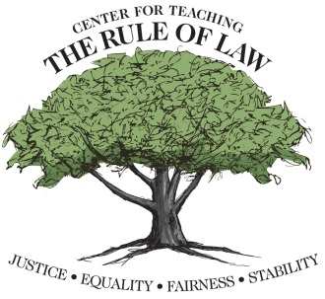
The Center wishes to thank Scott Crawford for his contributions in developing this material.
© Copyright 2017 Center for Teaching the Rule of Law

