Slide 1
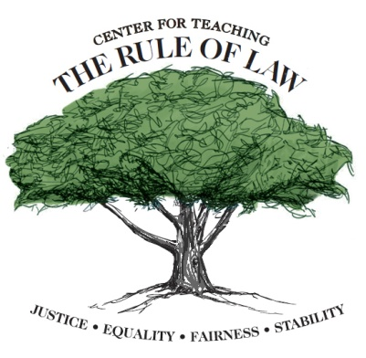
Rule of Law:
The Right to Question
Game
This project is financially assisted by a generous grant from the Virginia Law Foundation. The Virginia Law Foundation promotes through philanthropy the rule of law, access to justice and law-related education.

Slide 2
HERE ARE TODAY’S CATEGORIES

Slide 3
Rule of Law
A-E

Slide 4
Rule of Law
F-J

Slide 5
Rule of Law
K-O

Slide 6
Rule of Law
P-T

Slide 7
Rule of Law
U-Y

Slide 8
Rule of Law
Z-????

Slide 9
Rule of Law A-E
Rule of Law F-J
Rule of Law K-O
Rule of Law P-T
Rule of Law U-Y
Rule of Law Z-????
F
F
A
F
A
K
K
P
P
U
U
Z
A
K
P
U
Z
Z
?
B
G
L
?
L
Q
Q
V
V
?
M
??
H
R
W
??
C
W
??
X
X
???
I
N
S
X
???
D
???
Y
Y
????
J
O
T
Y
????
E
????
The Ultimate Question!

Slide 10
To change the Constitution, you need to enact one of these

Slide 11
What is an Amendment?

Slide 12
The First 10 Amendments to the Constitution

Slide 13
What is the Bill of Rights?

Slide 14
The Branch of the Federal Government that makes the laws

Slide 15
What is the Congress?

Slide 16
In Greek, this word means “Government by the People”

Slide 17
What is Democracy?

Slide 18
Presidential Act of January 1, 1863 that freed the slaves in the Confederate States

Slide 19
What is the Emancipation Proclamation?

Slide 20
This guarantees freedom of speech, religion and the press

Slide 21
What is the First Amendment?

Slide 22
The system by which a city, state or nation is controlled

Slide 23
What is Government?

Slide 24
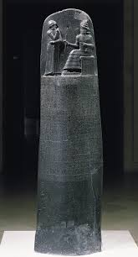
One of the earliest written set of laws

Slide 25
What is Hammurabi’s Code?

Slide 26
The presumption in law that puts the burden on the state to prove the defendant’s guilt

Slide 27
What is (the presumption of) Innocence?

Slide 28
The authority of a court to rule on the constitutionality of a law

Slide 29
What is judicial review?

Slide 30
A Hereditary Ruler

Slide 31
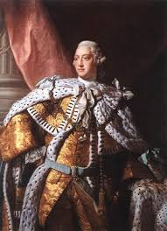
What is a King?

Slide 32
Thomas Jefferson said this tree “must be refreshed from time to time with the blood of patriots & tyrants”

Slide 33
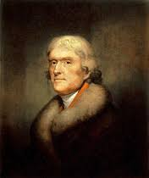
What is (the Tree of) Liberty?

Slide 34
Document sealed by King John in 1215

Slide 35
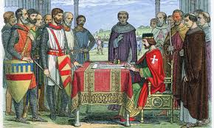
What is Magna Carta?

Slide 36
The belief that certain rights and duties apply to all people

Slide 37
What is Natural Law?

Slide 38
Prolonged cruel or unjust treatment or control

Slide 39
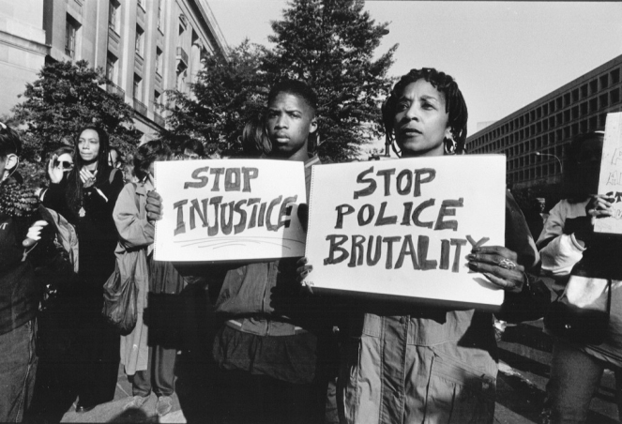
What is Oppression?

Slide 40
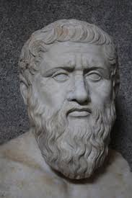
Greek Philosopher who advocated rule by enlightened Kings

Slide 41
Who is Plato?

Slide 42
The 3rd Amendment put a stop to this military practice

Slide 43
What is quartering of troops?

Slide 44
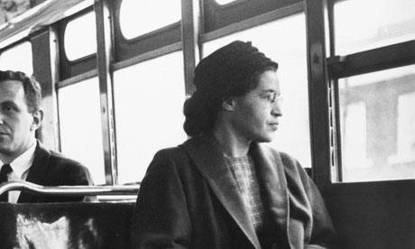
She is an icon of the Civil Rights Movement

Slide 45
Who is Rosa Parks?

Slide 46
The Boston Tea Party was held in response to this

Slide 47
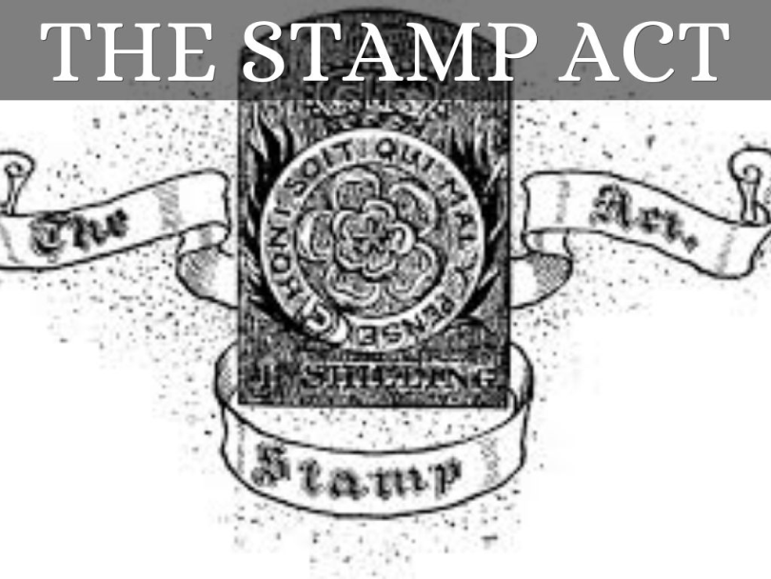
What is the Stamp Act?

Slide 48
This novel by Harper Lee tells the story of a citizen lawyer seeking justice for a black man in the pre-Civil Rights South

Slide 49
What is To Kill a Mockingbird?

Slide 50
A collective labor bargaining group

Slide 51
What is a Union?

Slide 52
Exercise this right to choose your elected representatives

Slide 53
What is (the right to) vote?

Slide 54
The 4th Amendment protects against this type of search

Slide 55
What is warrantless (searches)?

Slide 56
A form of search common at security checkpoints

Slide 57
What is an X-Ray (search)?

Slide 58
The last battle of the American Revolution was fought here

Slide 59
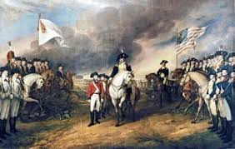
Where is Yorktown, Virginia?

Slide 60
Policy requiring the strict enforcement of the law

Slide 61
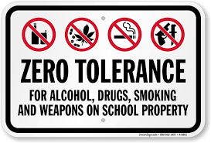
What is Zero Tolerance?

Slide 62
Document signed in Philadelphia on July 4, 1776

Slide 63
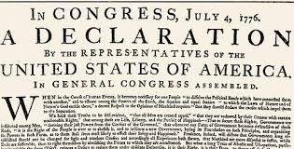
What is the Declaration of Independence?

Slide 64
The group of citizens charged with determining the facts at a trial

Slide 65
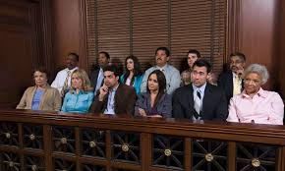
What is a Jury?

Slide 66
Money paid by a citizen to support the government

Slide 67
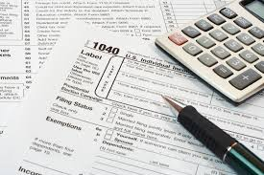
What is a tax?

Slide 68
He said, “No man is above the law, and no man is below it.”

Slide 69
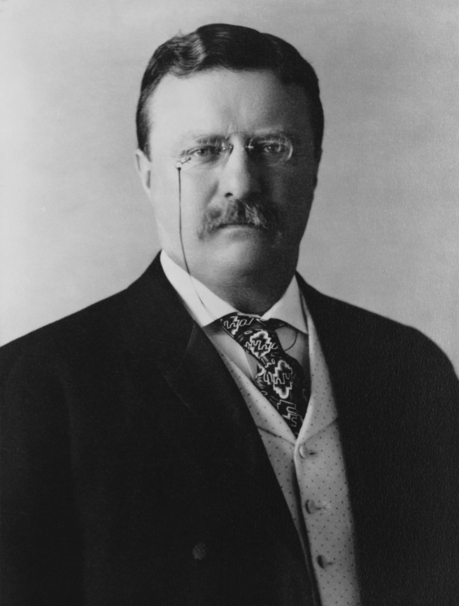
Who is Theodore Roosevelt?

Slide 70
The Ultimate Question

Slide 71
Rights + Responsibilities equals this

Slide 72
What is the Rule of Law?

