Slide 1
THE RULE OF LAW IN AMERICA: TRYING TO GET IT RIGHT
This project is financially assisted by a generous grant from the Virginia Law Foundation. The Virginia Law Foundation promotes through philanthropy the rule of law, access to justice and law-related education.
© 2017 The Center for Teaching the Rule of Law

Slide 2
THE SEVENTEENTH CENTURY: “A CITY ON A HILL”
Governor John Winthrop, courtesy of The Library of Congress
The Mayflower Compact 1620, Jean Leon Gerome Ferris, 1932
“A Model of Christian Charity,” 1630
“… we must be knit together … as one …, we must be willing to abridge ourselves of our superfluities, for the supply of other’s necessities, we must uphold a familiar commerce together …, having before our eyes … our community as members of the same body….”
“We … do … solemnly and mutually … covenant and combine our selves together into a civil body politic … to enact, constitute, and frame such just and equal laws, ordinances, acts, constitutions and offices, from time to time, as shall be thought most meet and convenient for the general good of the Colony, unto which we promise all due submission and obedience.”
Notes:
The landing of the “Pilgrims” at Plymouth in 1620 provided us with a blueprint of for creating a “civil body politic” that promoted mutual cooperation through the concept of a covenant or contract – a tool fully realized in 1787 with the creation of the American Constitution. But the “just and equal laws” mentioned in the “Mayflower Compact” and affirmed in subsequent documents such as the Declaration of Independence, the Constitution and Bill of Rights have frequently fallen short of the ideal.
Gov. John Winthrop of Massachusetts Bay Colony preached in 1630 that the New World offered Puritans the opportunity to create “a city on a hill” with “the eyes of all people…upon us.” From Winthrop’s “city upon a hill” evolved the concept of American exceptionalism that remains a sometimes contentious part of the national psyche. Winthrop and well-meaning Americans of succeeding generations have spoken eloquently about the nation being “knit together…as one” and of the importance of the common good. Other voices have argued passionately about individual injustices endured as a result of religious intolerance, racial and ethnic bigotry, economic inequality, and a host of other failed promises that this group sees as American arrogance and elitism.
The point of these conflicts is the tension inherent in creating a “civil body politic” based on the rule of law that has driven our citizens to struggle for five centuries to get the rule of law right for everyone.

Slide 3
THE EIGHTEENTH CENTURY: “ALL MEN ARE CREATED EQUAL”
The American Declaration of Independence, 1776
“We hold these truths to be self-evident, that all men are created equal, that they are endowed by their Creator with certain unalienable Rights, that among these are Life, Liberty and the pursuit of Happiness.”
Slave trader’s business in Atlanta, Georgia, 1864. Nearly 100 years after the Declaration of Independence proclaimed that “all men are created equal,” an entire race was being bought and sold as chattel, as property. But the enslaved were not the only ones denied equality: Women would also suffer second-class status and remain disenfranchised until the twentieth century.
Notes:
Under the soon to be written Constitution of 1787, members of the black race were considered 3/5s of a person.

Slide 4
THE NINETEENTH CENTURY: “MANIFEST DESTINY”
American Progress, 1872, John Gast
The Last of the Race, T.H. Matteson, 1847
Notes:
1. Expresses a powerful historical idea about the meaning of America’s “Manifest Destiny to unite the two coasts
Symbolic images:
Right side = the East; Rising sun, parting clouds provide light for the rolling hills and gentle rivers; all suggest the comforting civilized space that is the heart of the nation
Left side = Dark ominously clouded sky overshadows rugged mountains, suggesting a wild place ready to be tamed by the settlers from the East who bring with them all that Eastern civilization has to offer:
Transportation – the locomotive and the stagecoach, the roughly cut road
Communication – the telegraph being strung by the angelic female figure (NOTE: wing-like flourishes of her gown trailing behind her) who dominates the painting, pony express rider
Farming – oxen pulling a plow
Miners – men carrying shovels
But with expansion came a cost to the indigenous people of the Great Plains and western territories: Extinction of their way of life and cultural heritage
Native Americans being driven into the darkness in the left side of the painting
The bison and the bear being pushed out of their natural habitats to make room for a more civilized West
2. “Last of Their Race” (T.H. Matteson, 1847) depicts the plight of Native Americans as a result of Manifest Destiny’s near genocidal extinction of America’s indigenous people. The characters are huddled against the cold, sitting and standing on a rocking precipice. The “father” stands looking at the setting sun, partially covered by heavy dark clouds. They have no place to go, reflected in the downcast heads of the two figures to the right and left of the “father” who stands gazing with a dignified and possibly defiant attitude out to sea. The seated figure in the foreground, by contrast, looks back to the east to the land they left behind, the land stolen from them by war, broken treaties, and U.S. government policies.

Slide 5
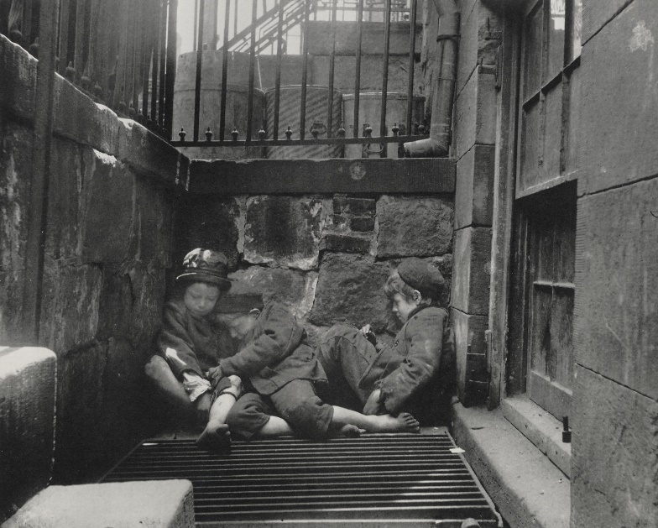
THE NINETEENTH CENTURY: “GIVE ME YOUR TIRED, YOUR POOR"
“Lower East Side Taylor Shop,” Ca. 1890, Jacob Riis, ©Bettmann/CORBIS
“Give me your tired, your poor,
Your huddled masses yearning to breath free,
The wretched refuse of your teeming shore.
Send these, the homeless, tempest-tossed, to me:
I lift my lamp beside the golden door.”
Emma Lazarus, 1886
“Children Sleeping on Mulberry Street, N.Y.,” 1889, Jacob Riis, From the Jacob Riis Collection (#123), Museum of New York
Notes:
Once more the torch of liberty that promised a bright future to millions of immigrants had its dark cloud of sweat shops and street urchins forced to find warmth on heating grates.

Slide 6
THE TWENTIETH CENTURY: CIVIL RIGHTS
Anonymous, “The First Picket Line – College Day in the Picket Line,” 1917, Library of Congress
David L. Carlton, www.Vanderbilt.edu, 2009
Public Domain
Dorothea Lange, 1942
Notes:
From Abagail Adams’ comment to her husband, “What about the women, John?” in response to the Declaration of Independence statement that “all men are created equal,” to the Seneca Falls Convention of 1848 to the Women’s suffrage movement of the 20th Century; women have struggled to gain their civil rights, including the right to vote – a right finally won in 1920 with the ratification of the 19th Amendment.
Internment of Japanese Americans during WWII denied the rule of law to thousands of American citizens simply because they were of Japanese ancestry. While some internees had their property cared for and protected by friends, others lost everything to the unscrupulous who saw this as an opportunity to increase their property and wealth by seizing the property of the unfortunate internees. The American government would later pay reparations to most of the interned Japanese Americans and their families.
Jim Crow Laws and “separate but equal” ruling of the U.S. Supreme Court in the Plessy vs. Ferguson case (1896) reversed by the landmark civil rights decision in the Brown v. Board of Education case of 1954
Gender equity

Slide 7
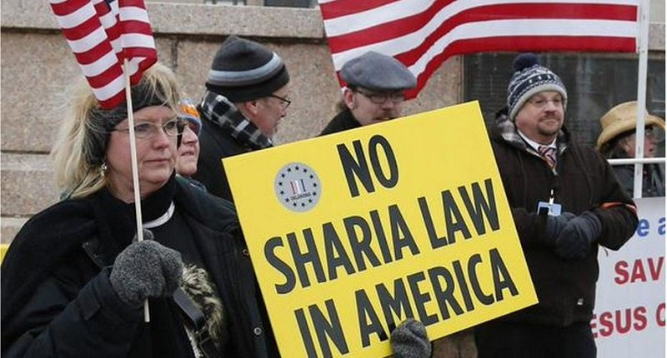
THE TWENTY-FIRST CENTURY: THE TENSION CONTINUES
Melissa Golden, June 13, 2012
http://goldenhourblog.com/2012/06/13/pipelineprotest
http://www.rawstory.com/wp-content/uploads/2015/10/antimuslim-protest-800x430.jpg
The U.S. Bill of Rights: Amendment I
Congress shall make no law respecting an establishment of religion, or prohibiting the free exercise thereof; or abridging the freedom of speech, or of the press; or the right of the people peaceably to assemble, and to petition the Government for a redress of grievances.
“Respect Immigration or Expect Resistance,” February 4, 2017, Pax Ahimsa Gethen (https://commons.wikimedia.org/wiki/File:NoBanNoWall_SF_20170204-1728.jpg
Notes:
Once more we are facing a national debate about religious tolerance and immigration
Since the mid 19th century, Americans have argued about the use of our land and the natural resources it provides, creating tension between the rights of individual property owners and the needs of the community/nation
Today, as in times past, The Bill of Rights is being tested in ways James Madison and his generation never imagined. But with a firm commitment to the rule of law and its principles of fairness and equality, The Bill of Rights will continue to act as the guarantor of individual rights and the common good.

Slide 8
THE RULE OF LAW: THE TENSION CONTINUES
EQUALITY
FAIRNESS
FREEDOM
STABILITY
SECURITY
JUSTICE
INDIVIDUAL
RIGHTS
COMMON
GOOD
Notes:
NOTE: Here is an opportunity for teachers to apply this idea of tension to contemporary national and global issues.

Slide 9
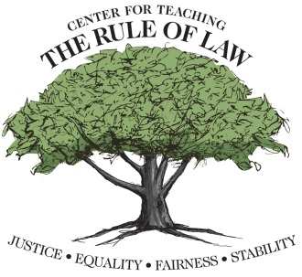
© Copyright 2017 Center for Teaching the Rule of Law

