Slide 1
THE RULE OF LAW AND SOCIETY
THE RULE OF LAW AS SEEN THROUGH THE VISUAL ARTS
This project is financially assisted by a generous grant from the Virginia Law Foundation. The Virginia Law Foundation promotes through philanthropy the rule of law, access to justice and law-related education.

Slide 2
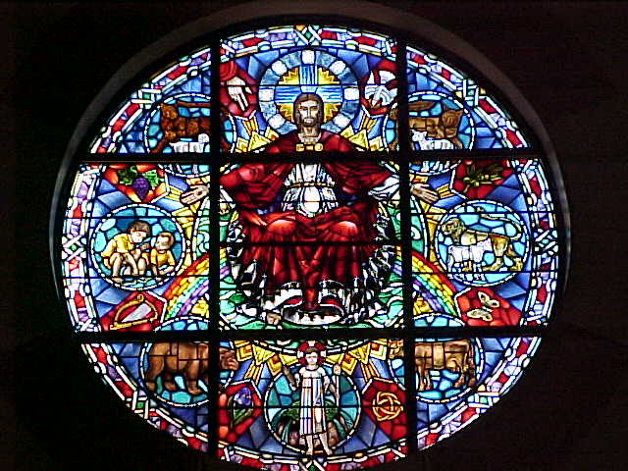
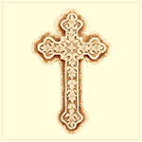
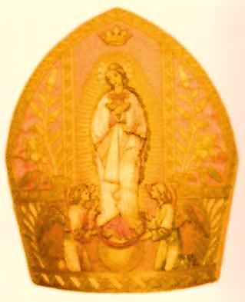
MEDIEVAL ICONS: THE SACRED
Notes:
Massive structure of cathedral suggests the power of the Church
The towers soar skyward, pointing to heaven
Though not visible here, the intricate carvings and decorative art tells the story of the Bible and its key figures
The rose window depicts the life of Jesus who sits in a welcoming position, suggesting He is the way to redemption and grace
Notice the images in the window – a bear, an ox, a lamb, children, a rainbow, a halo and cross, and the out-stretched hand above Christ’s right shoulder
The cross – the symbol of the Church and religious faith; originally an instrument of torture and death
The pope’s miter – the symbol of papal authority, the “crown” of the Church’s leader

Slide 3
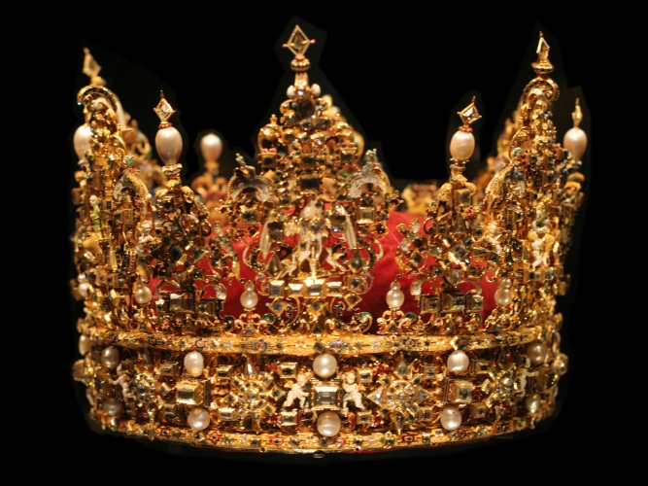
THE PROFANE
Notes:
The massive, stark castle is a defensive weapon of the secular world
Castles symbolize the feudal order of the middle ages where the king ruled with absolute authority
The royal crown represents that authority
The sword and shield are the weapons of war and conflict, symbols of the monarch’s power – rule by man
Note the cross-like shape of the sword, often used by warriors as a cross during prayer

Slide 4
IMPLICATIONS FOR THE RULE OF LAW
What implications do the images of “The Sacred” and “The Profane” have for Medieval citizens? Consider each image in each slide separately and collectively.
How are the words “sacred” and “profane” politically charged?
How does the rule of law attempt to address the tension between these two political views?
Notes:
While at first, Church and State were one with the secular rulers drawing their authority from the Church, as time passed, Medieval citizens were often pawns in a chess game played between the “sacred” world of the Church and the “profane,” secular world of feudal monarchs who had absolute control of the people
The words “sacred” and “profane” are politically charged because they represent the clash between a religious view of the world in which the Church exerted its authority over the people and the secular world in which absolute monarchs imposed their authority over the land, wealth, and lives of the people. This conflict intensified as economic forces created the guilds, and tradesmen and merchants began exerting demands for economic stability.
The ROL sought to limit the competing powers of these two forces by restraining the limits of their power to control peoples’ freedoms, individual rights, property rights, and liberty. Out of this conflict would arise the beginnings of the modern legal system – English Common Law, which established codified laws, especially the concept of due process; development of law schools, which laid the foundation for an established legal system; the political philosophy of Thomas Aquinas reaffirming that the law must be virtuous as well as just; and eventually the Protestant Reformation, which gave people more religious freedom, and would eventually lead to the separation of Church and State.

Slide 5
How do the two images below suggest the public virtue associated with the American democratic ideals?

Slide 6
GEORGE WASHINGTON, JEAN ANTOINE HOUDON, 1785-1791
Notes:
Notice Washington’s relaxed yet confident demeanor as he stands, walking stick in hand, looking into the distance as if surveying his property.
Difficult to see in this photo is the missing button at the bottom of his vest, suggesting yet again an informal air – he is the American common man, a farmer.
He rests on a fasces, a bundle of rods with a projecting ax blade used as a symbol of republican authority in ancient Rome – suggesting the new nation’s democratic republican system of government in which citizens elect their government officials, like George Washington.
Behind and resting against the fasces is a plow, symbol of his life as a gentleman farmer, again suggesting Washington’s role as a common citizen willing to serve his country.
Across the fasces hangs his sword, a symbol of his willingness to leave his life as gentleman farmer and take up arms as a citizen soldier to defend his republican ideals of the right to property ownership, freedom and liberty.

Slide 7
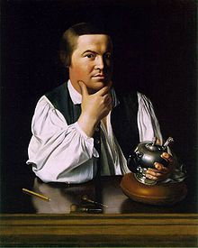
PAUL REVERE, JOHN SINGLETON COPLEY 1768
Notes:
Note the bright light that highlights Revere in this portrait, especially his head
The composition of the portrait relies on a series of “pointers” directing the viewer’s attention to Revere’s head – the seat of reason and common sense
Note the reflection on the workbench suggesting Revere’s reflective attitude as he gazes forth contemplatively, perhaps considering his skillful handiwork = a teapot
Here, too, we see a common man, a silversmith, pursuing his business
Together, the Washington statue and the Revere portrait depict the common man and the republican virtues of property ownership, self-employment, independence, and a willingness to fight to protect individual rights to life, liberty, and the pursuit of happiness – key principles of the rule of law.
Note, too, that both men seem to be reflecting on something beyond what the viewer sees; their reflective gaze calls to mind the Enlightenment, the age that inspired the founders to create a new political system based on common sense, individual reason, and public virtue.

Slide 8
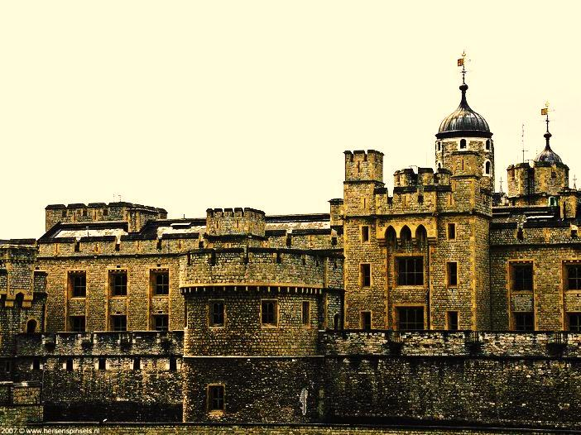
ABSOLUTE SOVEREIGNTY
The Tower of London and the two photos of the Royal Governor’s Palace all suggest the power of absolute monarchy. How so?
What implications do these photos have for the rule of law?
Notes:
All three photos clearly reflect the power of absolute rule, from the infamous Tower of London where people were imprisoned, tortured, and executed by the will of the monarch, to the Governor’s Palace with its symbols of royal authority on the entrance gate and the display of weaponry in the entrance hall.
What we see here are the elements of rule buy man, not rule of law.

Slide 9
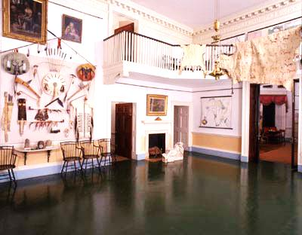
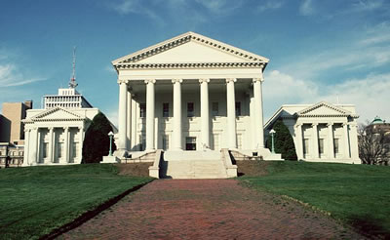
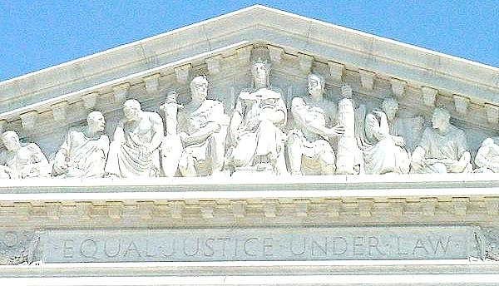
LIBERAL DEMOCRACY
Upper left: Monticello Upper right: Entrance Hall to Monticello
Lower left: Virginia State Capitol Lower Right: Portico of U.S. Supreme Court

Slide 10
LIBERAL DEMOCRACY
1. All four photos reflect classical Greek and Roman architectural designs. Why?
2. How to the entrance halls of the Governor’s Palace and Monticello reflect the differences between absolute monarchy and liberal democracy?
3. How do the images on the Supreme Court portico suggest the ideals of democratic republicanism and the rule of law?
Notes:
The classical architectural elements of these buildings reflect the classic influence of Greek democracy – direct democracy in which the people have a say in the laws that govern them – and the Roman influence of representative government – the people select representatives who govern by the peoples’ consent. These ideals became corner stones of the new American political system.
The Governor’s Palace entrance hall is foreboding with its many symbols of the monarch’s power, all of the weapons, and reminds visitors who makes and enforces the law. Monticello’s entrance hall is bright with benches that invite the visitor to sit and enjoy the decorations and objects that tell the story of a nation in which people are free to move about and pursue their own interests.
The images on the Supreme Court portico represent Roman republicanism. The central figure is Lady Liberty/Justice, crowned with a laurel wreathe and seated on a chair. On her left is a man holding a fasces, the symbol of republican authority and liberty; on her right is a man holding a sword, the symbol of power to enforce the law. The other figures are engaged in conversation, suggesting that a free, liberal democratic republican government depends on justice, the free exchange of ideas, the concept that the people have a voice in the law-making process, and that the people and government officials are bound by the law, all of this guaranteed and protected by the rule of law.

Slide 11
THE DREAM OF THE RULE OF LAW
How do these photos suggest the dream and ideals of the rule of law?
Notes:
The rule of law guarantees that everyone has a fair and equal chance at a good life, the right to pursue their own business interests, and that government will address the needs of the community through the principles of equality, stability, certainty, predictability, and fairness of the law.

Slide 12
THE NIGHTMARE OF THE RULE OF LAW
How do these images address the “nightmare” of the rule of law?
Notes:
The nightmare occurs when the rule of law is not applied fairly or equitably to all citizens. When government fails to consider the common good, individuals and groups often suffer the consequences of that neglect. Such was the case during the industrial revolution at the turn of the 19th and 20th century as depicted in these images.

Slide 13
THREATS TO THE RULE OF LAW
How do these cartoons from the 19th and 20th centuries threaten the rule of law?
What implications do they have for constitutional democracy?
Notes:
The cartoon on the left illustrates the threat to the rule of law when elected officials succumb to the influence of “big money” or special interest groups, a problem today as it was in the past.
The cartoon to the right exposes the threat to the rule of law and the Constitution when any branch of the government – in this case the Executive branch – exceeds its constitutionally limited powers as FDR attempted to do by packing the Supreme Court to advance his agenda.

Slide 14
ABUSE OF THE RULE OF LAW
Notes:
1. “Last of Their Race” (T.H. Matteson, 1847) depicts the plight of Native Americans as a result of Manifest Destiny’s near genocidal extinction of America’s indigenous people. The characters are huddled against the cold, sitting and standing on a rocking precipice. The “father” stands looking at the setting sun, partially covered by heavy dark clouds. They have no place to go, reflected in the downcast heads of the two figures to the right and left of the “father” who stands gazing with a dignified and possibly defiant attitude out to sea. The seated figure in the foreground, by contrast, looks back to the east to the land they left behind, the land stolen from them by war, broken treaties, and U.S. government policies.
2. McCarthyism: Black listing, false accusations, suspension of due process – the perversion of the rule of law for one man’s gain. The buckets of tar symbolize the blacklisting of innocent citizens by McCarthy’s false and intimidating accusations. Politicians push the iconic republican elephant toward the tower in an effort to support McCarthy’s self-serving agenda. The cartoon suggests what happens to the rule of law when it is perverted to serve one man’s or one party’s ambitions.
3. Internment of Japanese Americans during WWII denied the rule of law to thousands of American citizens simply because they were of Japanese ancestry. While some internees had their property cared for and protected by friends, others lost everything to the unscrupulous who saw this as an opportunity to increase their property and wealth by seizing the property of the unfortunate internees. The American government would later pay reparations to most of the interned Japanese Americans and their families.
4. Rosa Parks: Note the composition of this sculpture: Parks is more life-like and natural looking compared to the two white officers who look cartoonish; Parks is also dressed in a red, white, and blue outfit while the two officers are dressed in drab brown and grey. Also note the size of the white men’s heads – small-minded, pinheads? As one student noticed, the two officers are shaped like Ku Klux Klan hoods, their sunglasses suggesting the black eye holes of the hoods – an interesting observation. Here, we see the rule of law denied and the spark that would ignite the Civil Rights Movement of the 1950’s.

Slide 15
THE LAW RULES
Why is Lady Justice blindfolded?
What do the scales represent and what do you notice about their position?
Why does she carry a sword?
What do the books and scrolls represent to her left?
Why is there a globe to her right?
Why is justice depicted as a woman?
How does this image and the observations you have made embody the basic principles of the rule of law?
Notes:
Justice is or should be blind – fair and impartial
The scales of justice are balanced because the law treats everyone equally.
The sword represents that justice has the power to enforce the laws – that citizens and government officials are bound by the law.
The books and scrolls are the body of accumulated law upon which justice and society stand.
The globe suggests that justice and the rule of law are universal and are necessary to preserve and protect individual rights, freedoms, liberty, and the community good.
Historically, women were often viewed as symbols of maternal protection, purity, goodness, and virtue; all of these qualities – protection, purity, goodness, and virtue – are associated with the rule of law.
The ROL is a universal ideal that guarantees equality and fairness to everyone before the law, protects those who suffer injustice at the hands of the government, groups, or individuals, and provides equal access to an independent and impartial judicial system. In the end, the law rules, not man.

Slide 16
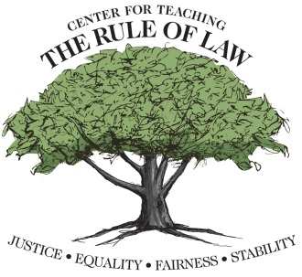
The Center wishes to thank Scott Crawford for his contributions in developing this material.
© Copyright 2017 Center for Teaching the Rule of Law
Notes:
Tree as Human-made Law Rooted in the ROL analogy:
The visible tree represents human-made law: legislative, customary, common law – these laws, like the tree, will wither and die if not supported by a strong root system grounded in the ROL (Ross L. Malone analogy)
ROL is a set of immutable principles derived from Divine Law, Natural Law, or the evolution of the human brain’s capacity to realize the need for mechanisms to protect itself and others
Tree of Knowledge of Good and Evil Analogy:
Genesis: Tree of Knowledge of Good and Evil produced the fruit that caused humans to lose Paradise
In this loss of innocence, humans also gained something: While gaining pain, suffering, despair, and death; they also gained knowledge of good and evil, right and wrong, the acceptable and the unacceptable.
They also gained the knowledge of how to control the tension between these opposing forces: That knowledge is the ROL.
In all the discussions of ROL (whether these are the words used or not), good, right, and acceptable play an important role in defining the concept.
From Plato and Aristotle to Thomas Aquinas, to the Founding Fathers Law must be good, right, and acceptable to preserve and protect the individual and society.

