Slide 1
What’s So Great About the Great Charter
A presentation for the
Center for Teaching the Rule of Law

Slide 2
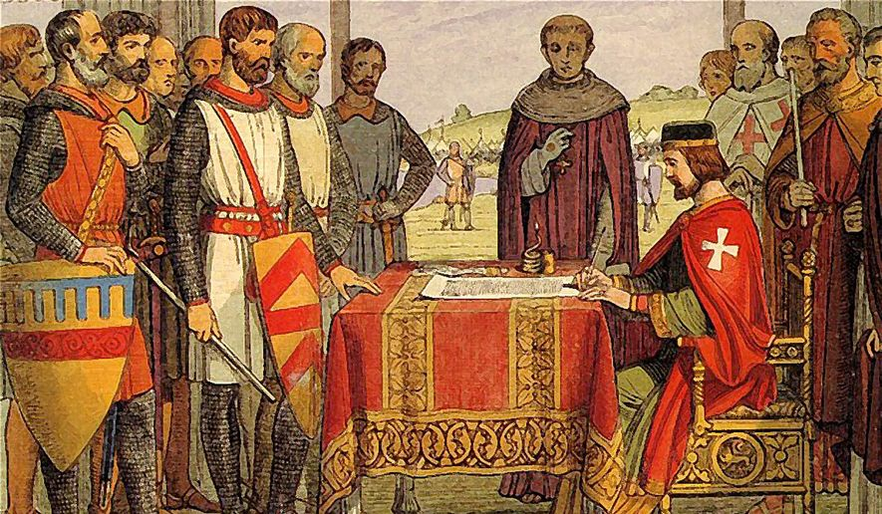
On June 15, 2015, the English King John placed his seal on Magna Carta Libertatum, the Great Charter of Liberties. English Barons, fearful of the Crown’s absolute power, were in revolt and the price of peace was that John should recognize the rights of the barons and the common people.

Slide 3
These banners were created as part of the celebration of the 800th anniversary of the sealing of Magna Carta in 2015. Follow this side trip on your journey to learn how the Great Charter was to influence political thought for generations, right up to the American Revolution and beyond.

Slide 4
Celebrate
Magna Carta Libertatum, Latin for “The Great Charter of Liberties” is the preeminent example of the agreements that came from these struggles between authoritarian rule and the desire for a local say in government.
In England, following the death of Richard the Lionheart, the barons compelled his successor to agree to relinquish some of his power.
Magna Carta was the document that stated what the king could and could not do without consent of the barons and the people.
In the Ancient World both the Greek City States and the Roman Republic at times were functioning democracies.
But with the fall of the Roman Republic, Monarchy and Imperialism became the dominant forms of government through the Middle Ages.
Beginning in the 11th century, however, lesser nobles and the citizens of “free towns,” began to assert pressure on the national governments for more rights.
Magna Carta
June 15, 1215
Runnymede Pavilion

Slide 5
Celebrate
Magna Carta
June 15, 1215
Although the King John and many of the English rulers after him often ignored the principles set out in Magna Carta, we can recognize in those principles the foundation of the rights and responsibilities found in our Constitution, especially those restrictions on the government found in the Bill of Rights.
Foundation of Constitutionalism

Slide 6
Celebrate
Magna Carta
June 15, 1215
Perhaps the most astounding concept in Magna Carta is that by its very existence it stands for the principle that a King or other ruler who claimed the right to govern as “God-given,” could be subject to a written law.
The God-given right of kings embodied the concept that the King could do no wrong and, thus, was not bound by any law.
However, Magna Carta begins with the principle that there are certain things the King could not do without the consent of his nobles, and in some cases the common people.
Government Bound by the Law
Executive
Legislative
Judicial

Slide 7
Celebrate
Magna Carta
June 15, 1215
One of the main objections the nobles had to the power of the monarchy was the idea that all property was held as the gift of the king.
That is, everything in the kingdom, but most especially its land, belonged to the king and could be taxed or taken away without the consent of the person who held the property.
Also, when a person died, all his property immediately returned to the king, and the king was not bound to permit the heirs to recover the property.
Magna Carta set out rights with respect to “private property” – a new concept.
Protection of Property Rights

Slide 8
Celebrate
Magna Carta
June 15, 1215
Although the phrase “Rule of Law” does not appear in Magna Carta, its concepts are seen throughout the document.
The Rule of Law not only requires that the government (meaning the King) is bound by that law, but that everyone is bound by it.
Magna Carta also emphasized the importance of stability in the law.
Both before and after Magna Carta, much of the law was based on an unwritten “common law,” but the charter established the importance of having written law that could not be changed by common law.
Rule of Law
A Global Ideal

Slide 9
Celebrate
Magna Carta
June 15, 1215
One of the most revolutionary concepts in Magna Carta was the idea that the King could not impose taxes at will.
Because under the old order there was no private property, the king could impose taxes (in effect “rent” for using his property) without any regard to ability or willingness of the nobles and common people to pay them.
After Magna Carta, at least in theory, there would be no more “taxation without representation.” The King would need permission of a Parliament of Lords and Commons to raise new taxes.
Taxation with Consent

Slide 10
Celebrate
Magna Carta
June 15, 1215
The words “due process of law” are not found in Magna Carta – indeed they would not appear in any legal document in English for many hundreds of years.
But the concept of due process, the idea that a government cannot subject an individual to some punishment or prescription with a formal process of law, was clearly set out in the limits the charter placed on the power of the king.
Foundation of Due Process
© Copyright Center for Teaching the Rule of Law 2016

Slide 11
Celebrate
Magna Carta
June 15, 1215
Arguably, the most important aspect of Magna Carta is that although it was a bargain between the king and the nobles, it also recognized the rights of common people.
Magna Carta was among the first legal documents to recognize that all people, not just the rich and powerful, were entitled to protection under the law.
While the charter did not abolish all distinctions of class, it did stand for the principle that in the most important matters there should not be one set of laws for the “nobility” and another for the “common folk.”
Equality of Justice

